Slide 1
H₂O Training (18th October, 2017)
Pre-workshop (09:15 – 10:00)
Sign in / setup equipment etc.
Extra time for H₂O install
Morning Session (10:00 – 12:00)
Introduction
Machine Learning Basics
Hands-on: Regression
Hands-on: Classification
Lunch Break (12:00 – 13:00)
Second Session (13:00 – 15:00)
Hands-on: Clustering
Hands-on: Features Extraction
Model Deployment Overview
Q & A Session (15:00 onwards)
Extra 1: Driverless AI Demo
Extra 2: Tree Algorithms Deep Dive
Extra 3: Features Engineering

Slide 2

About Me
Civil (Water) Engineer
2010 – 2015
Consultant (UK)
Utilities
Asset Management
Constrained Optimization
EngD (Industrial PhD) (UK)
Infrastructure Design Optimization
Machine Learning + Water Engineering
Discovered H₂O in 2014
Data Scientist
2015 – 2016
Virgin Media (UK)
Domino Data Lab (Silicon Valley)
2016 – Present
H₂O.ai (Silicon Valley)
How?
bit.ly/joe_kaggle_story

Slide 3
From Engineering to Data Science
Knowledge Driven Decision Making
Write code to deal with data based on knowledge and assumptions.
Strong domain knowledge.
Data Driven Decision Making
Define a problem and collect data related to the problem.
Write code to show data to computers and let computers (algorithms) find patterns in data.
Domain knowledge is helpful but not necessary.

Slide 4
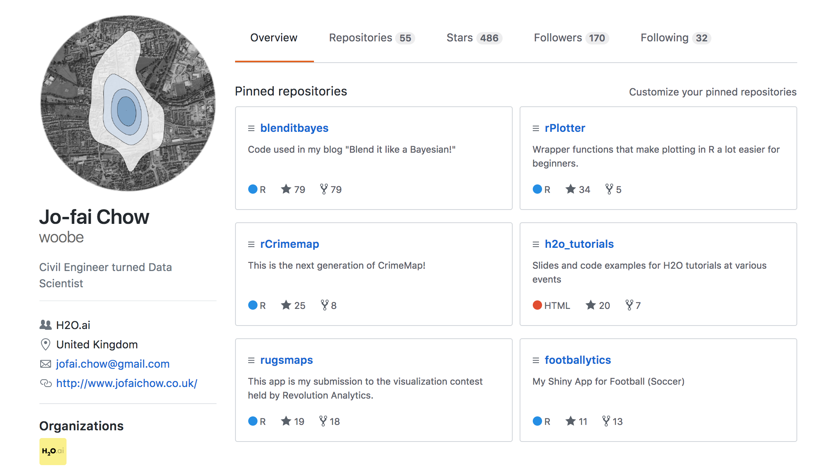
About Me – I ❤️ R

Slide 5
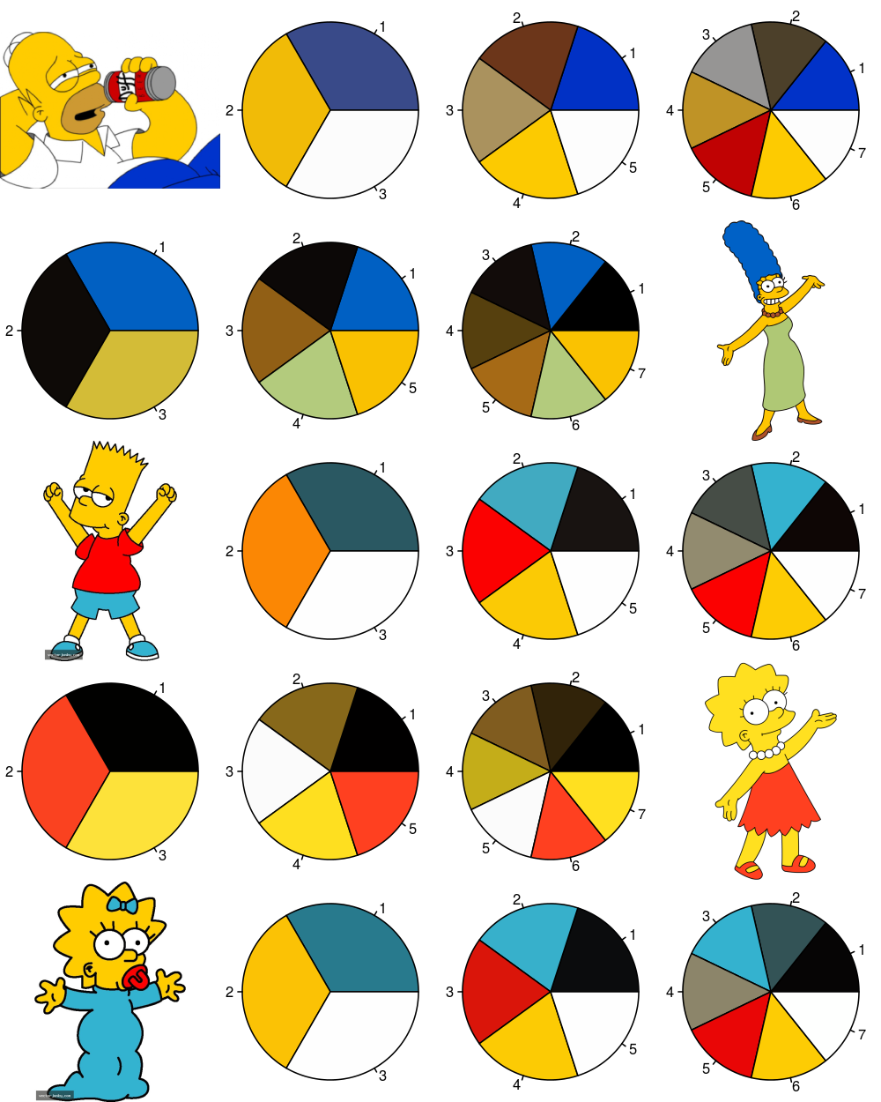
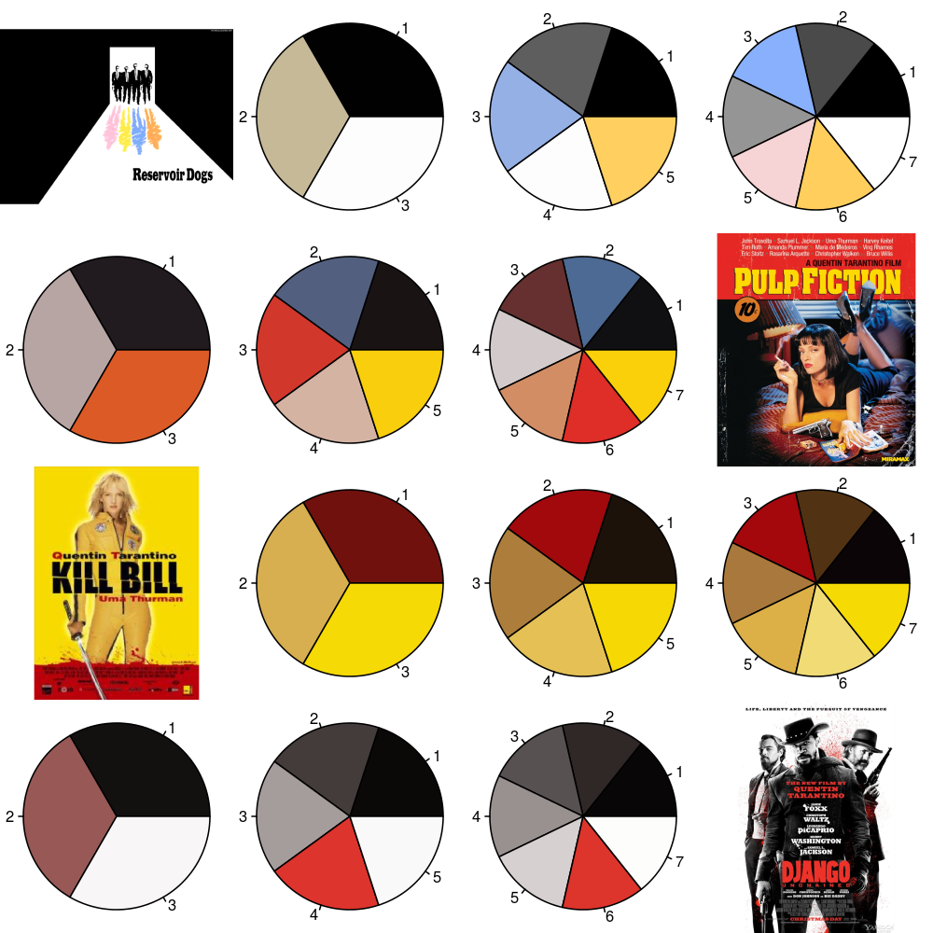
About Me – I ❤️ Colours
Developing R Packages for Fun
rPlotter (2014)

Slide 6
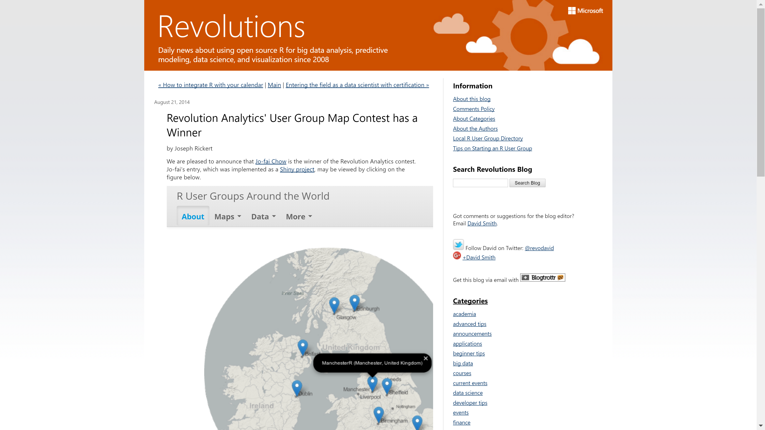

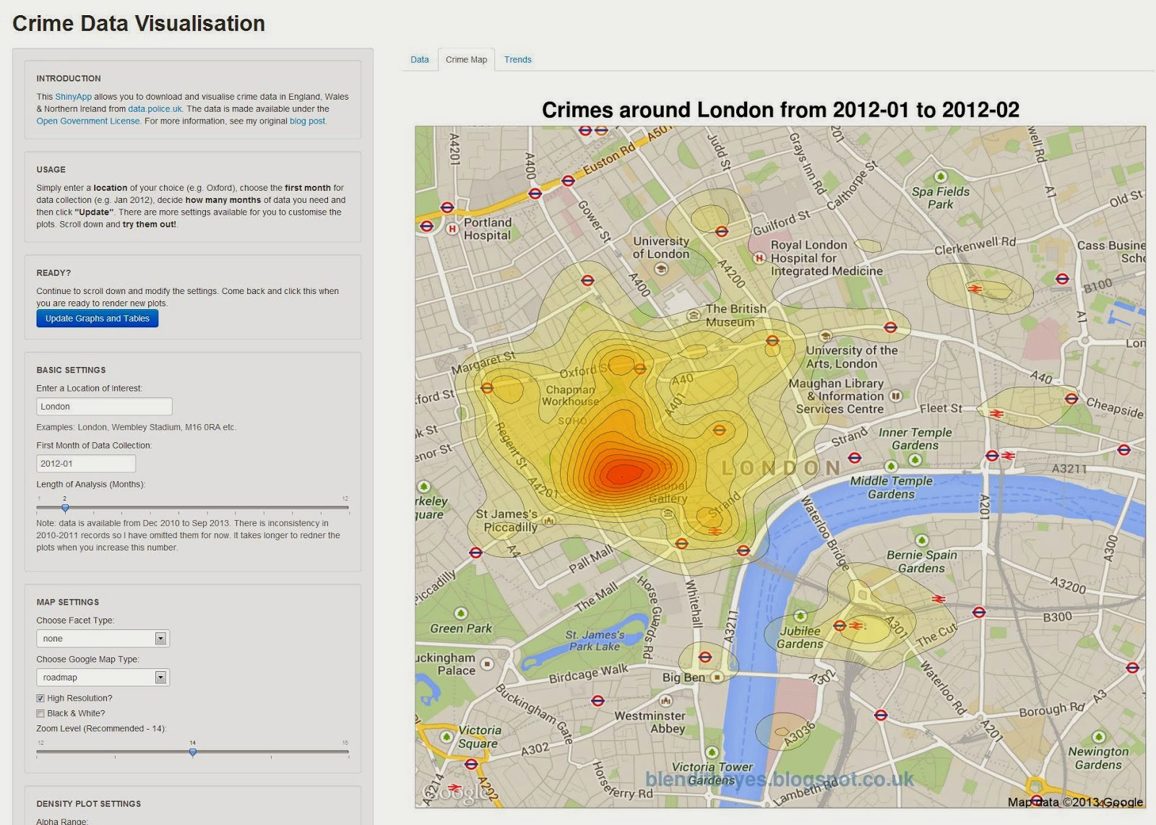
About Me – I ❤️ DataViz
My First Data Viz & Shiny App Experience
CrimeMap (2013)
Revolution Analytics’ Data Viz Contest
RUGSMAPS (2014)

Slide 7
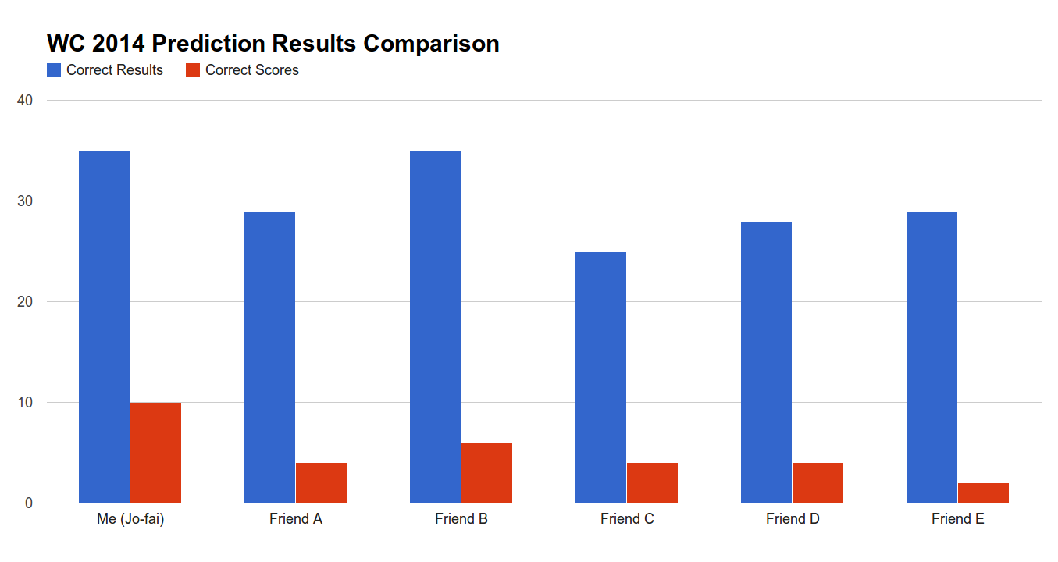
About Me – I ❤️ Football
Machine Learning vs My Friends
Team performance data from web
Simple machine learning models
(I didn’t know anything about H₂O at this time)
Objective: Predict Correct Score
Me : 10 out of 64 (15.6%)
Friends’ Avg : 4 out of 64 (6.3%)

Slide 8
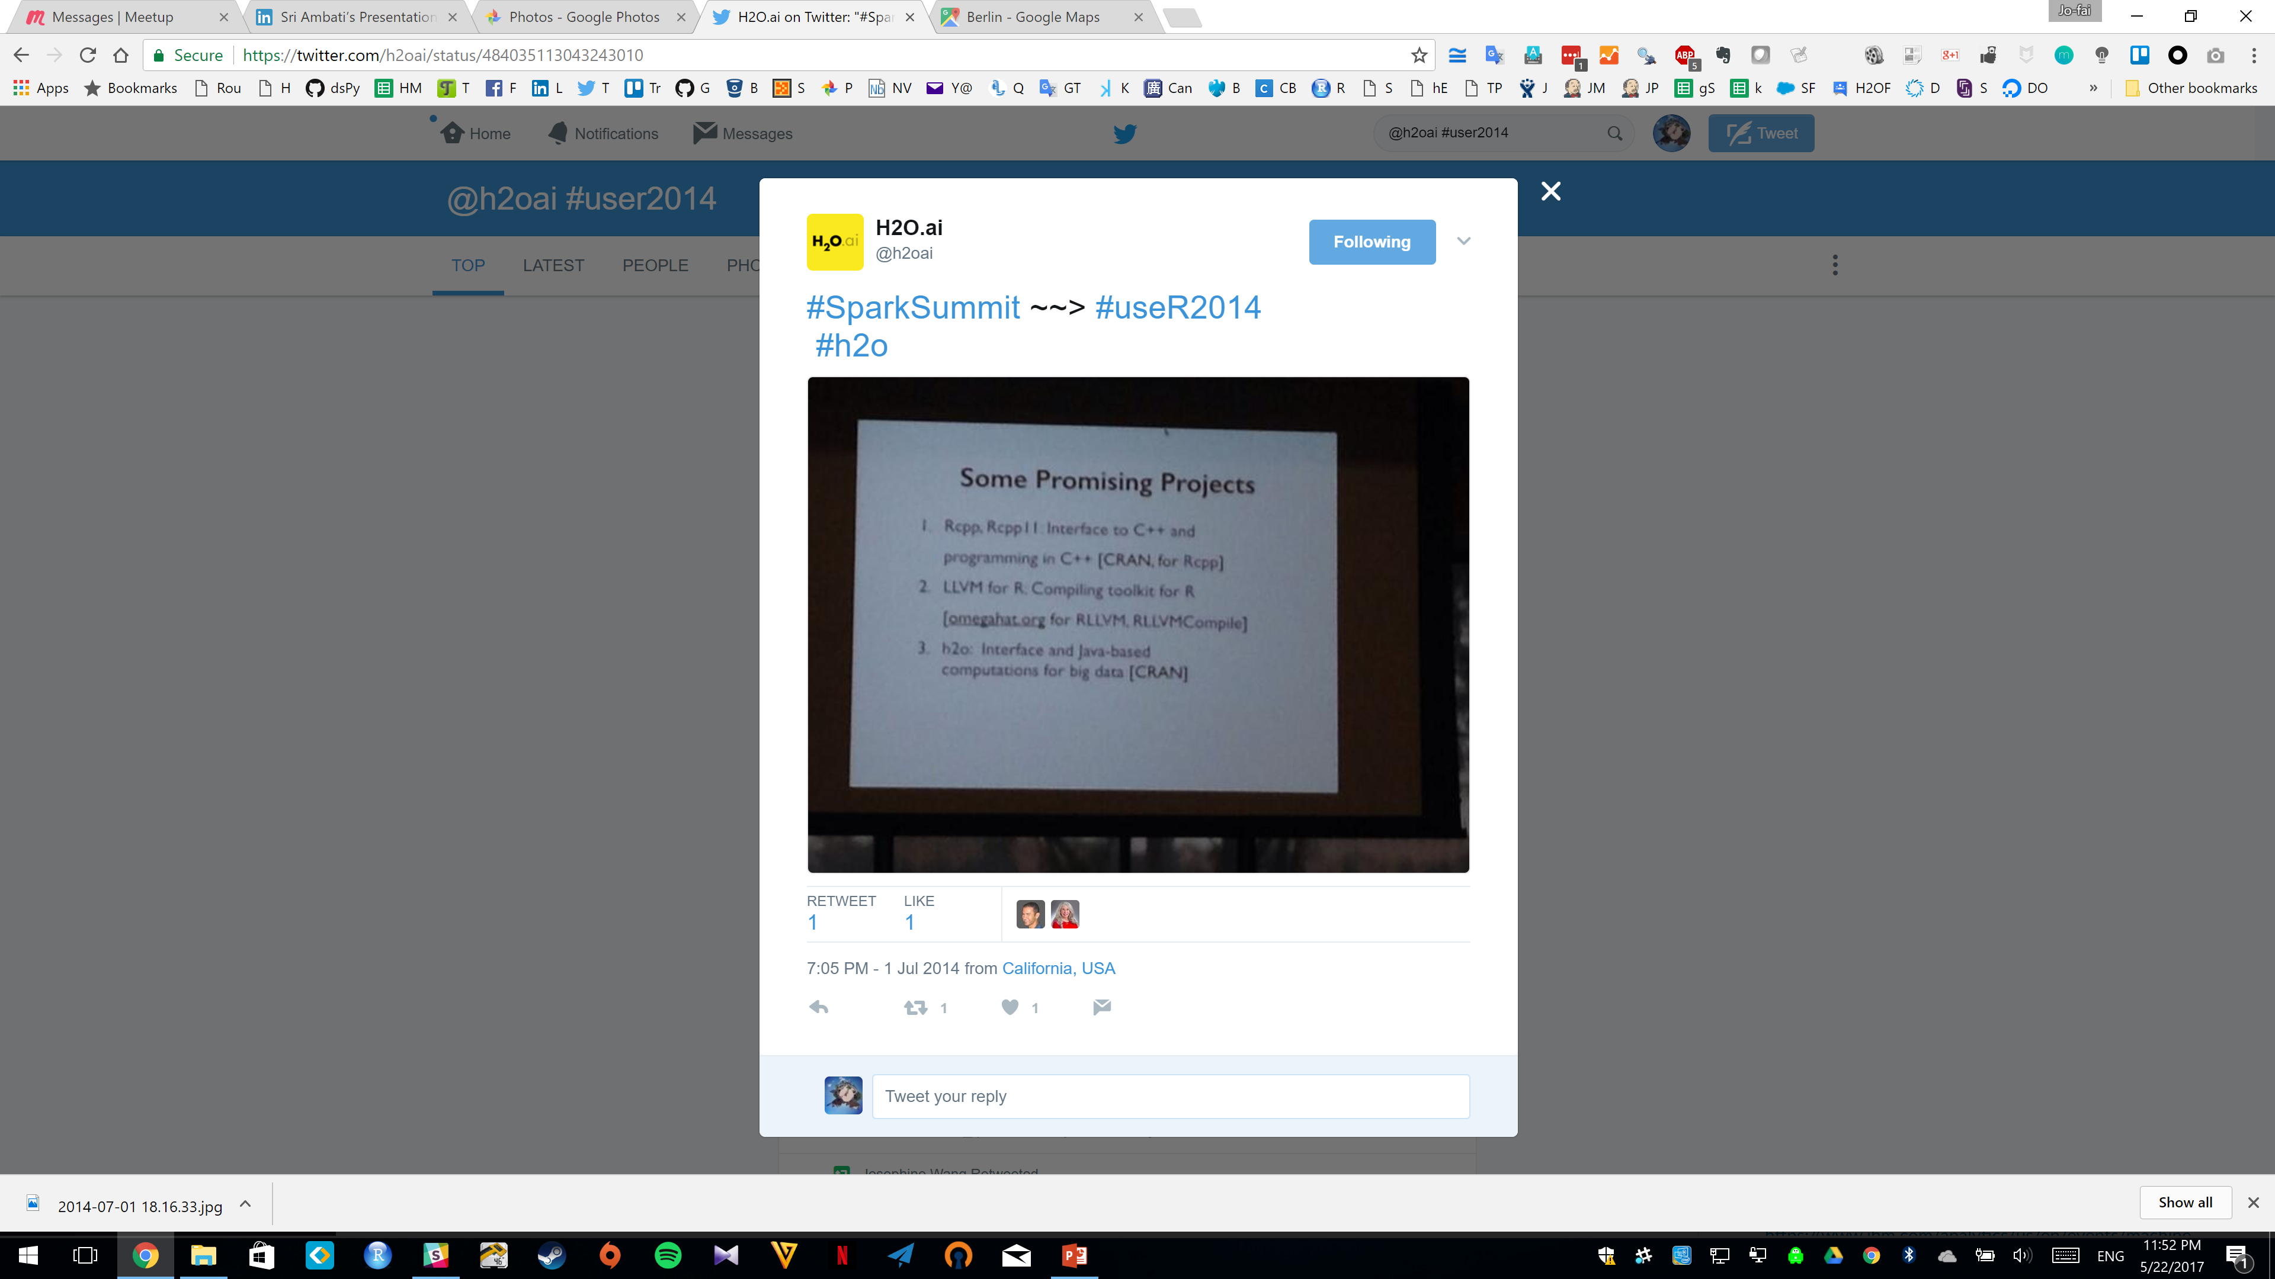
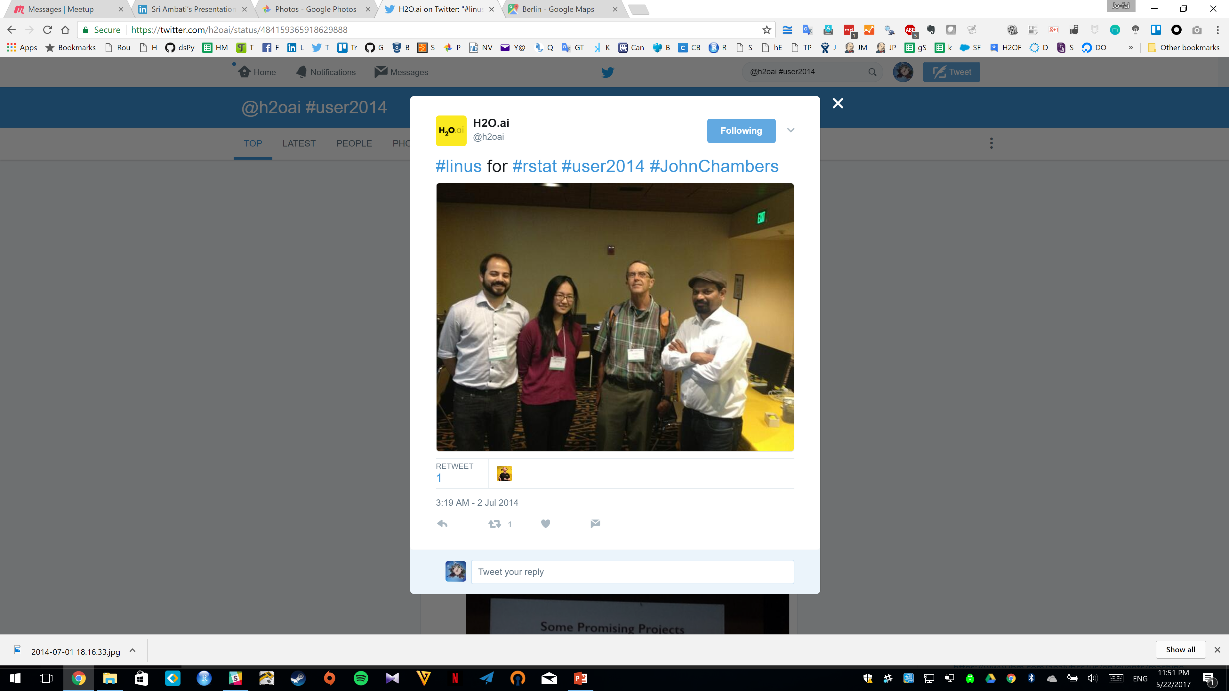
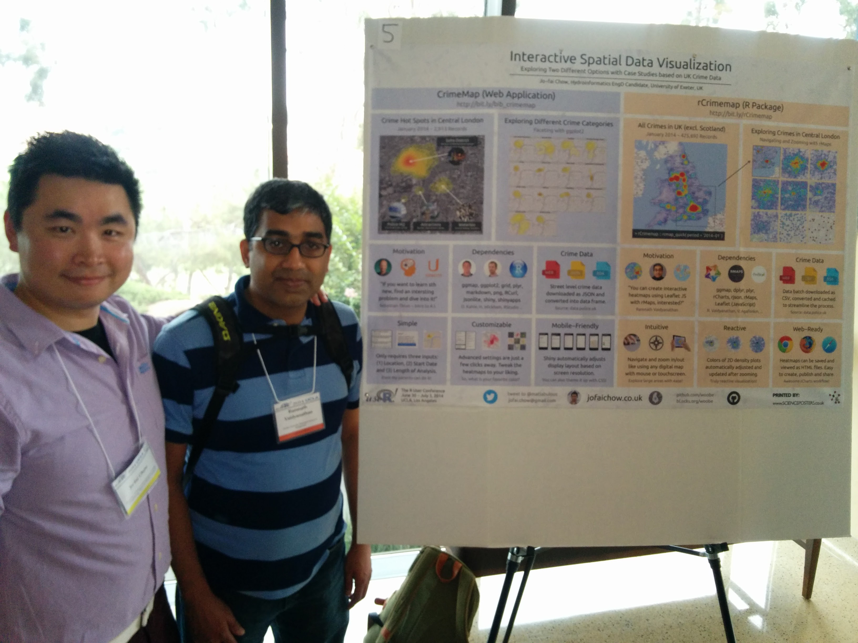

useR! 2014
CrimeMap -> poster
John Chambers mentioned H₂O
… so I gave it a try

Slide 9
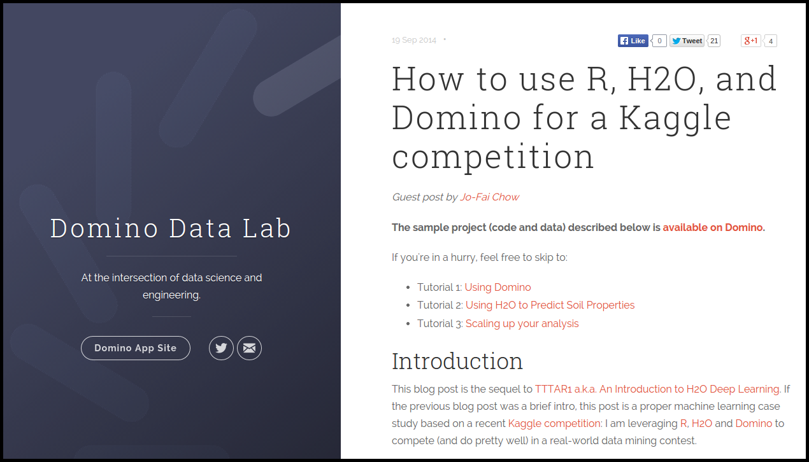
About Me – I ❤️ Kaggle
The Long Story
bit.ly/joe_kaggle_story
R + H₂O + Domino for Kaggle
Guest Blog Post for Domino & H₂O (2014)

Slide 10
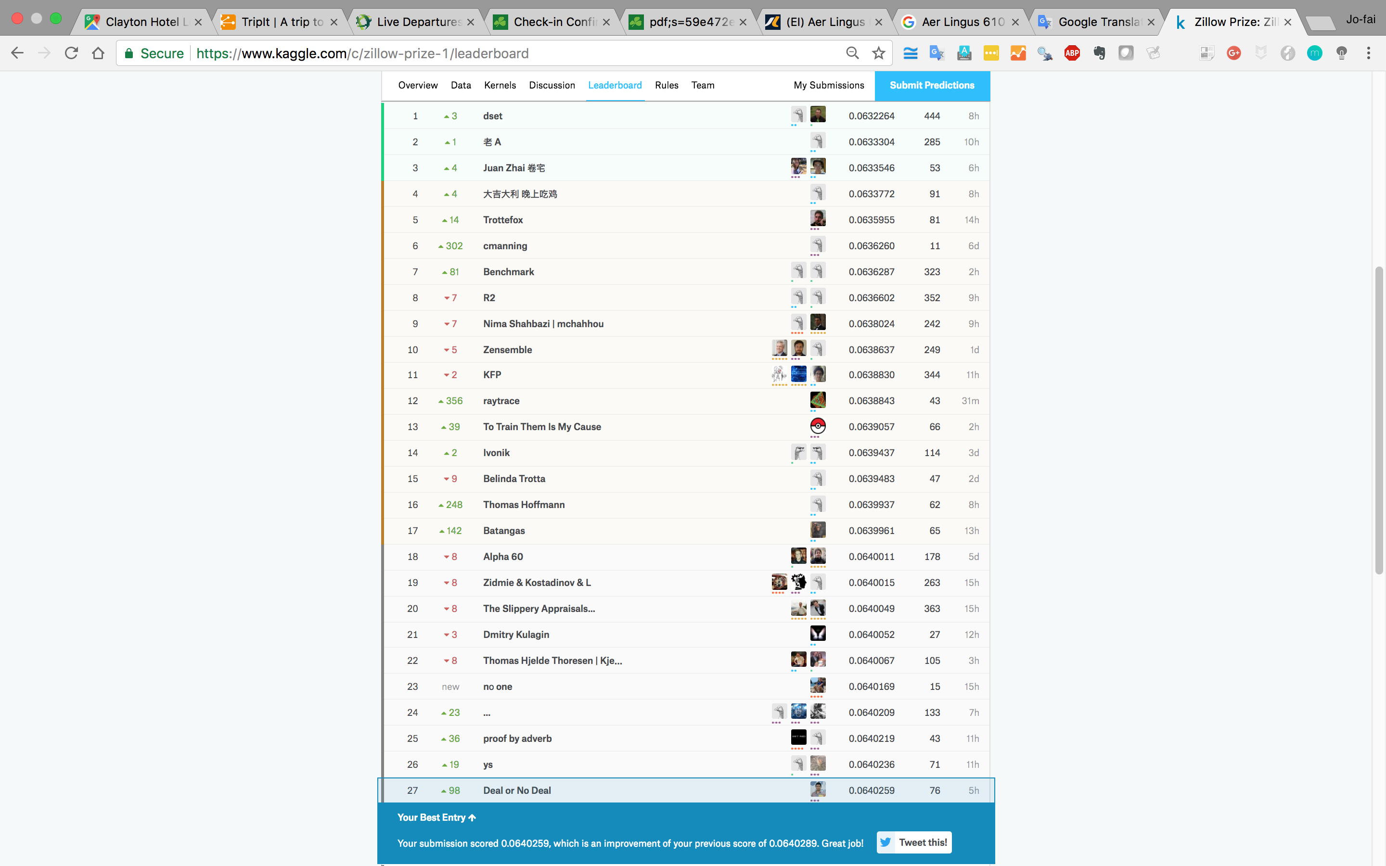
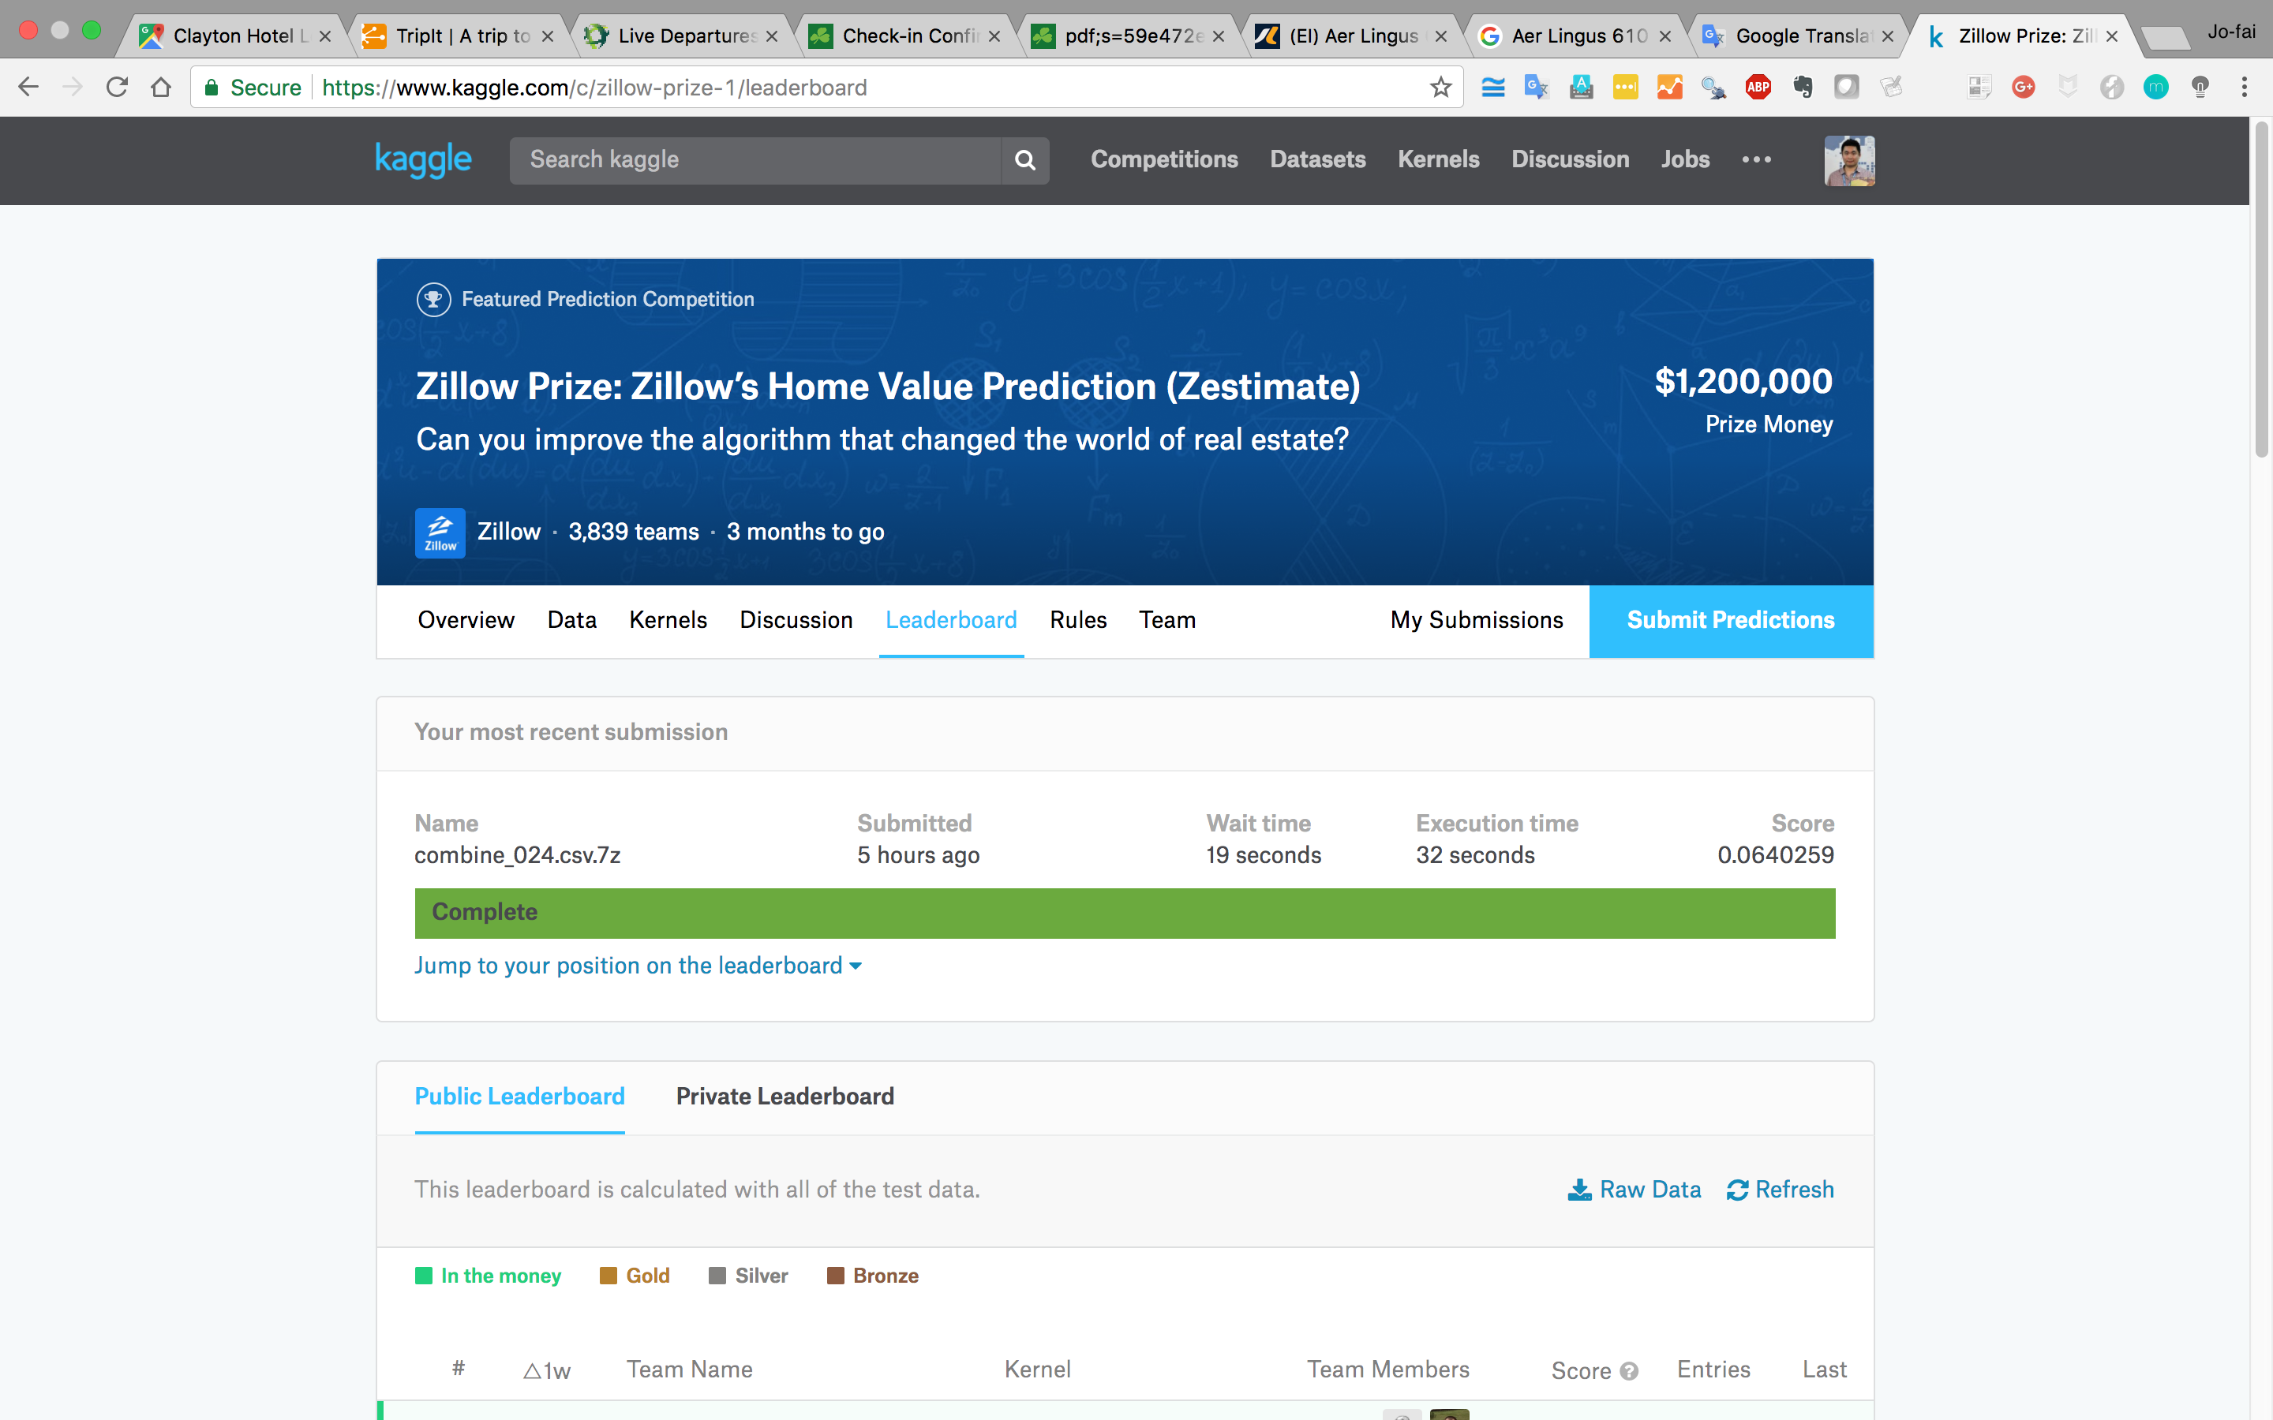
Some of the H₂O Kagglers
Marios Michailidis (#3, former #1)
Mathias Müller (#5, former #4)
Dmitry Larko (#54, former #25) –
The mastermind behind Driverless AI
… and his father (#36, former #3)
Joe (#829 out of 66,126, former #181)
… trying to catch up ...

Slide 11

Introduction to H₂O

Slide 12

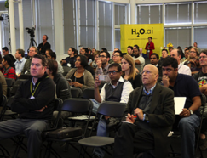


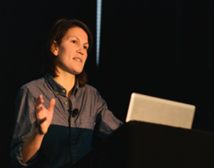
Company Overview
Founded | 2011 Venture-backed, debuted in 2012
Products | H₂O Open Source In-Memory AI Prediction Engine Sparkling Water (H₂O + Spark) Enterprise Steam Driverless AI
Mission | Operationalize Data Science, and provide a platform for users to build beautiful data products
Team | 75+ employees Distributed Systems Engineers doing Machine Learning World-class visualization designers
Headquarters | Mountain View, CA

Slide 13
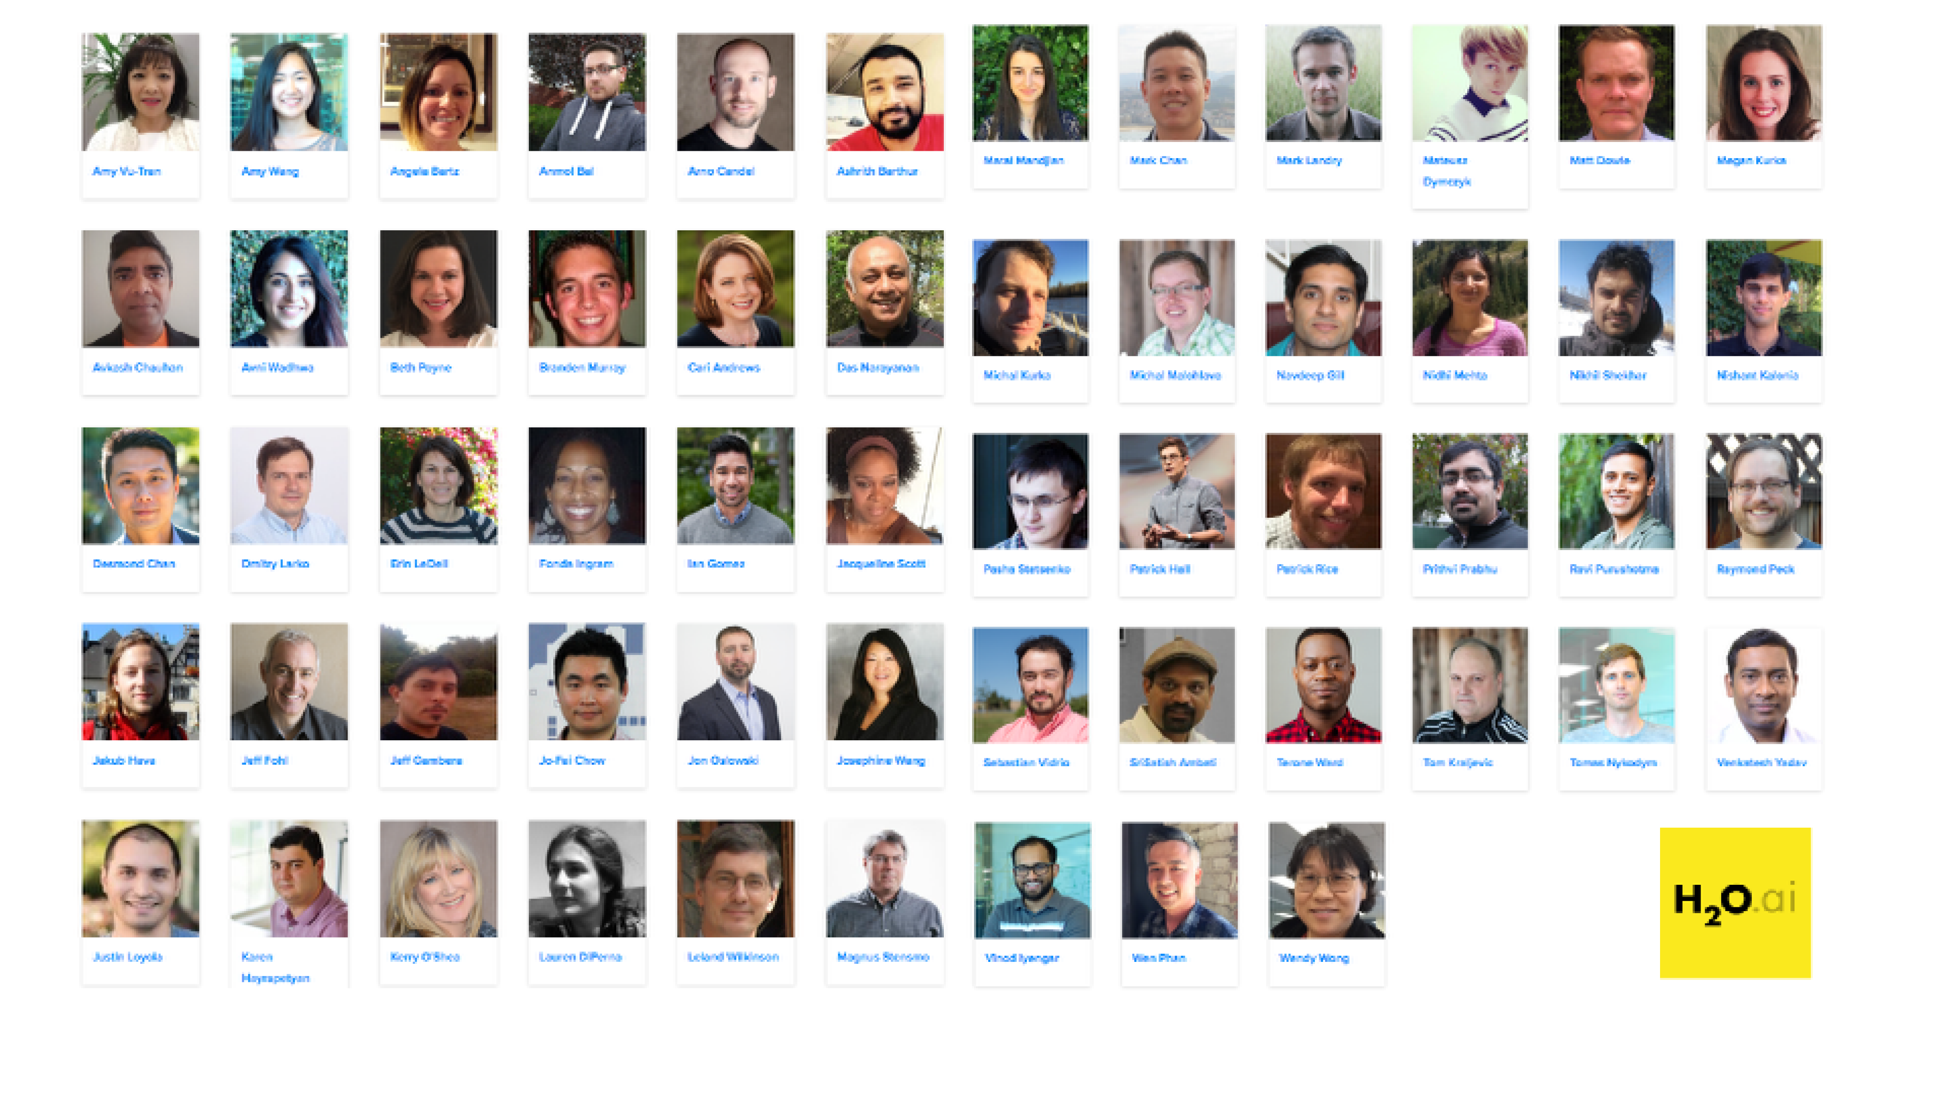
Joe (UK)

Slide 14


Scientific Advisory Council

Slide 15
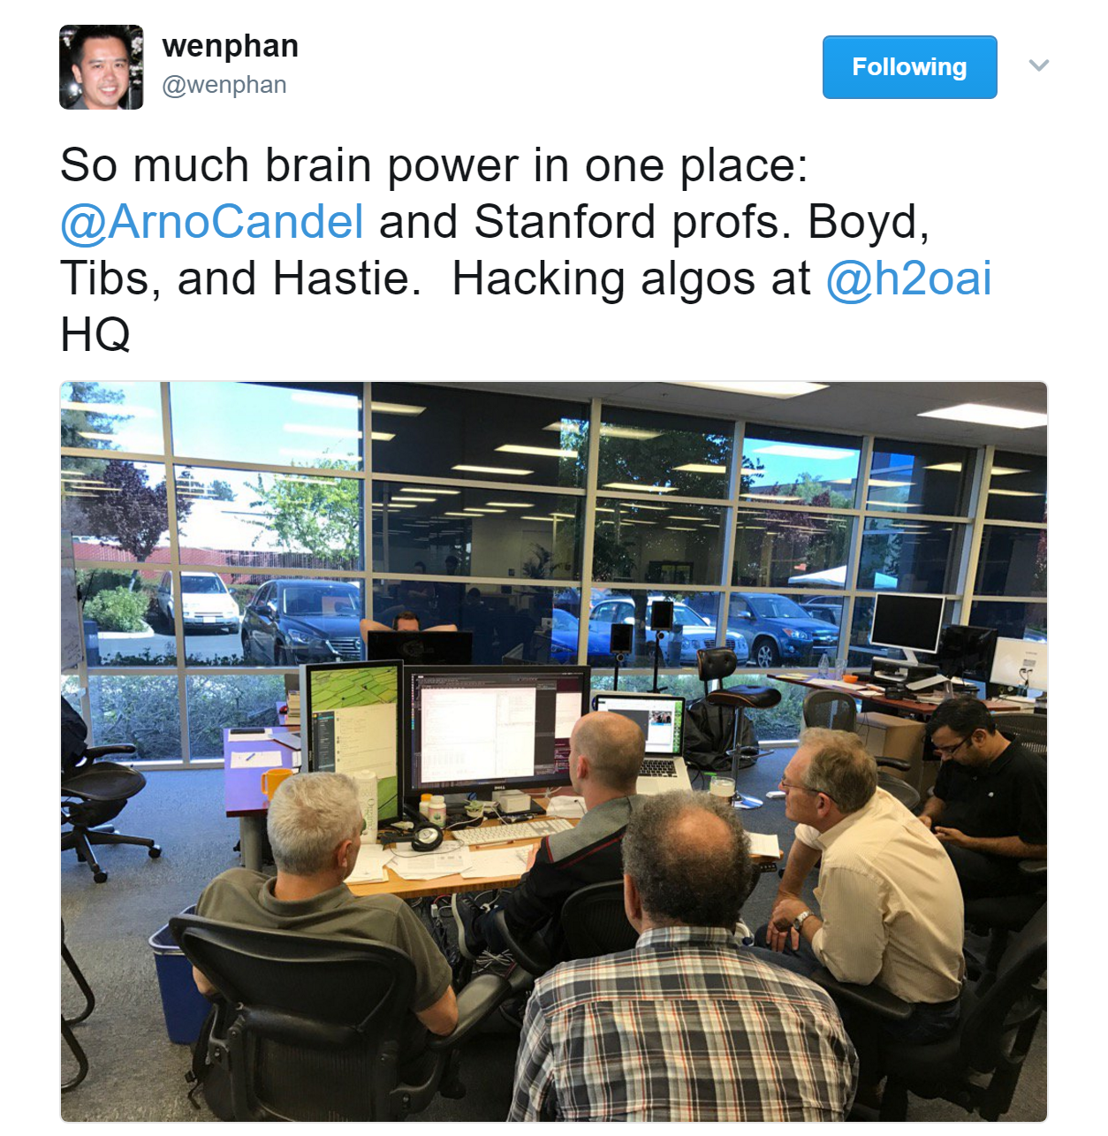
Arno (CTO)

Slide 16
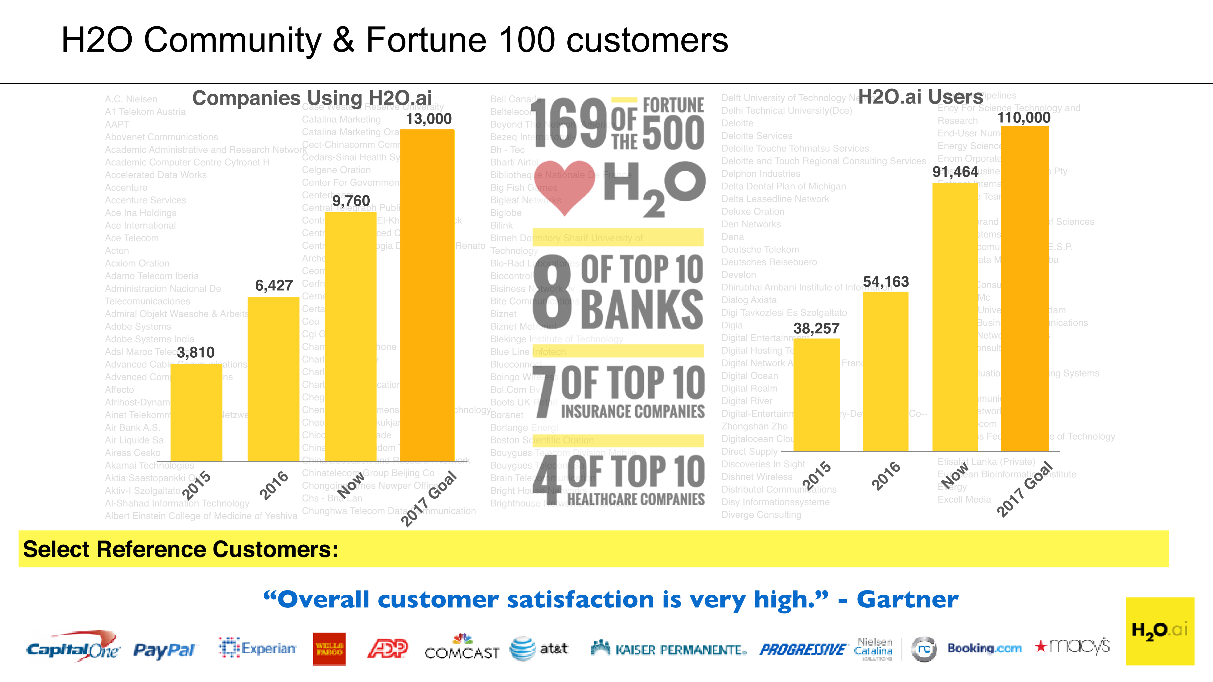
H₂O Community Growth

Slide 17








AI in Financial Services
Wholesale / Commercial Banking
IT Infrastructure
Know Your Customers (KYC)
Anti-Money Laundering (AML)
Security Cyberlake
DoS Detection and Protection
Master Data Management
Retail Banking
Card/Payments Business
Deposit Fraud
Customer Churn Prediction
Auto-Loan
Transaction Frauds
Real-time Targeting
Credit Risk Scoring
In-Context Promotion
One of Today’s Hands-on Examples

Slide 18
































Select Customers
Retail
Healthcare
Marketing
Financial
Advisory & Accounting
Insurance
Telecom
“Overall customer satisfaction is very high.” - Gartner
Notes:
Get a better icon for Advisory and accounting category, use the work assurance, Consider using graphs behind to scale, make it a normal curve, Horizontal, Fortune 500 customers, How many are using H2O

Slide 19
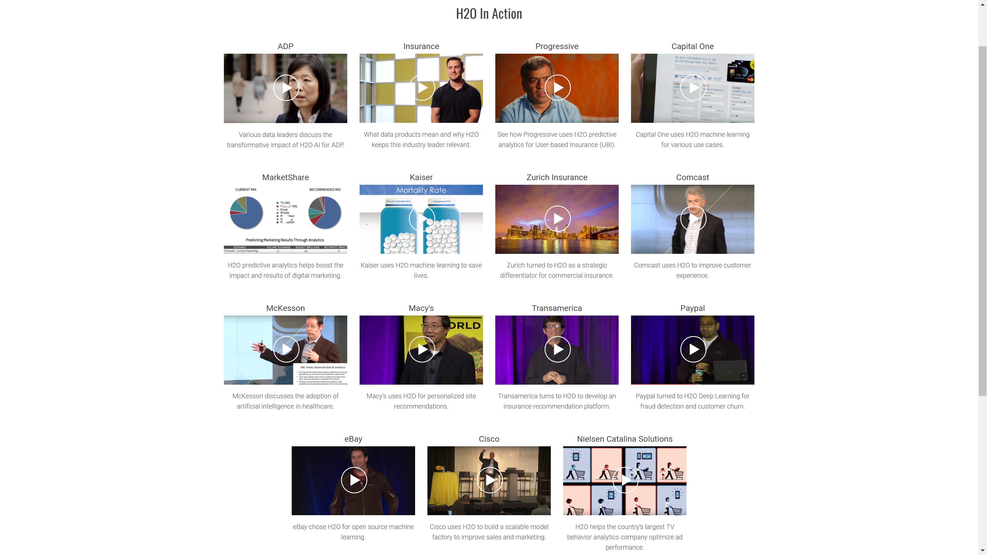
Check out our website
h2o.ai

Slide 20
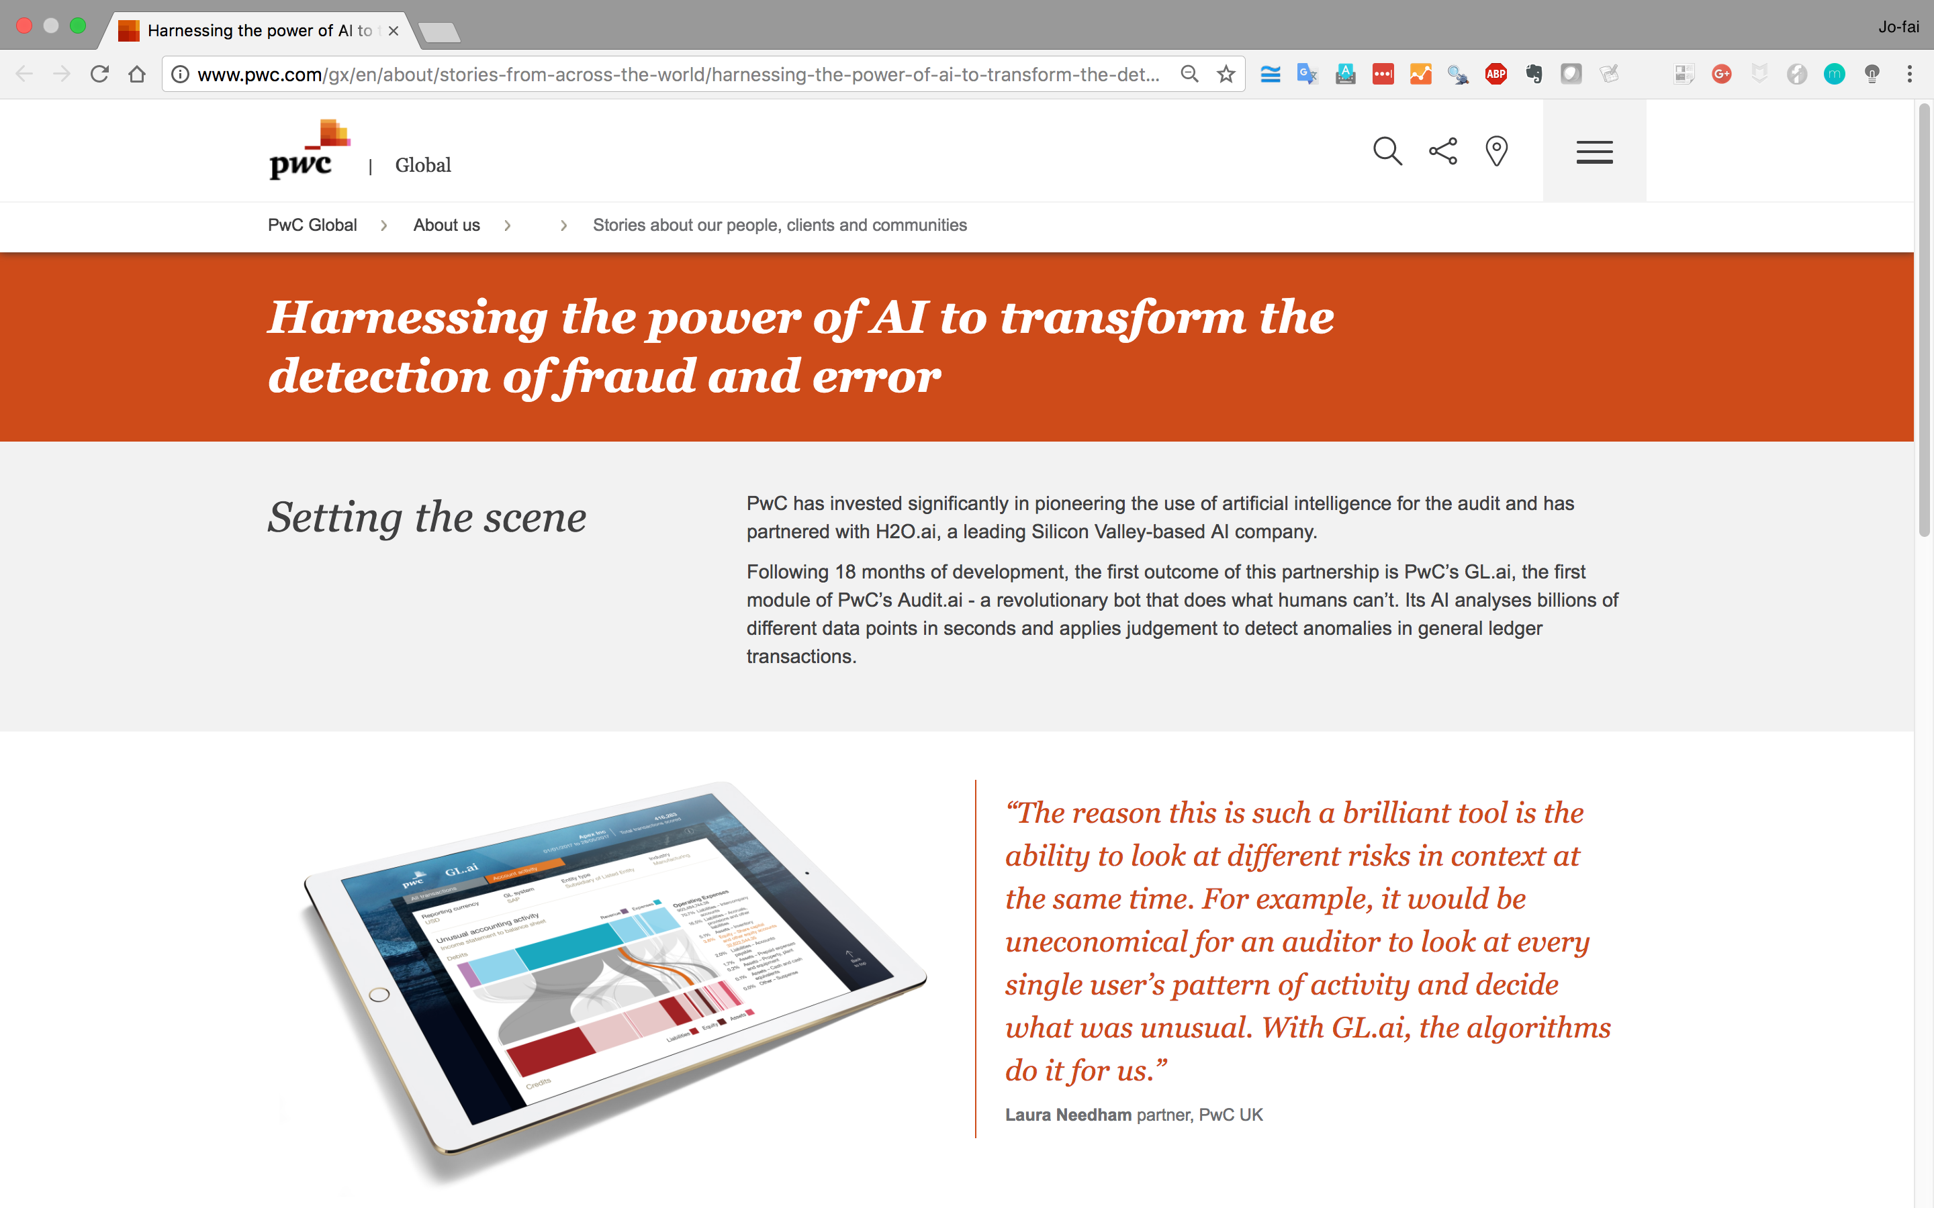

Award-Winning Application (PwC + H₂O.ai)
http://www.pwc.com/gx/en/about/stories-from-across-the-world/harnessing-the-power-of-ai-to-transform-the-detection-of-fraud-and-error.html
Notes:
Works on Hadoop & Spark
Key capabilities
Distributed in-memory algorithms
Columnar compression
Feature Engineering
EDA
Data Munging
Supervised Learning Algorithms
Unsupervised Learning Algorithms
Model deployment via POJO

Slide 21
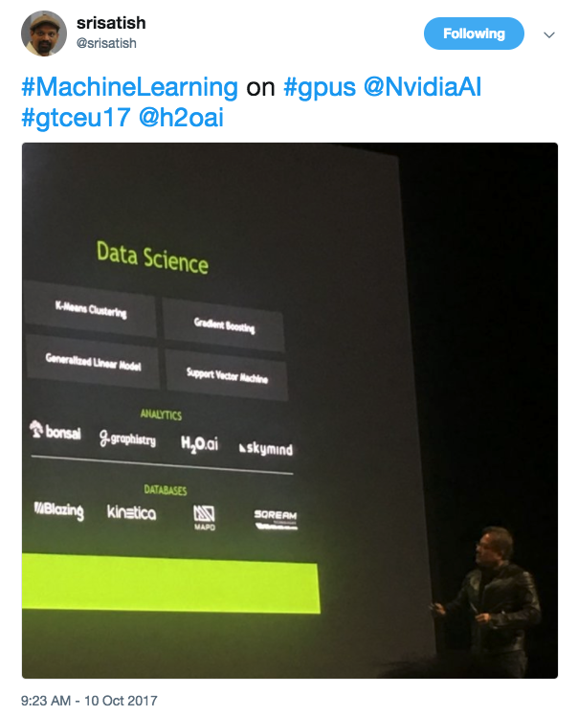
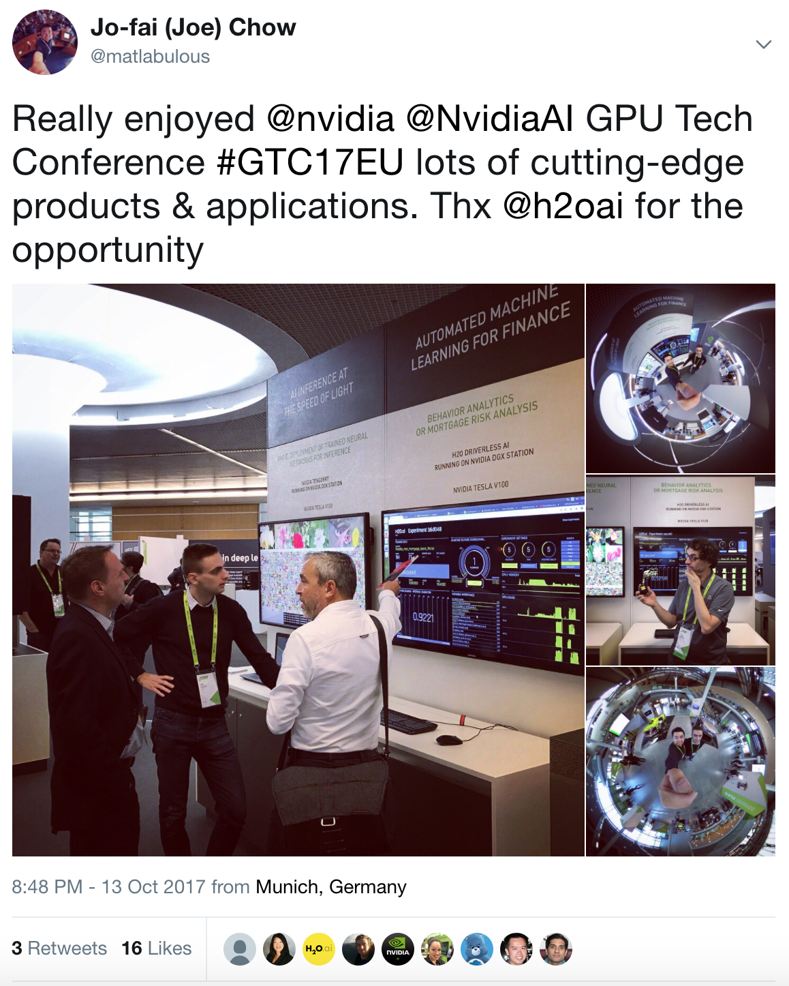
Driverless AI demo running on DGX Station (Nvidia + H₂O.ai)
Notes:
Works on Hadoop & Spark
Key capabilities
Distributed in-memory algorithms
Columnar compression
Feature Engineering
EDA
Data Munging
Supervised Learning Algorithms
Unsupervised Learning Algorithms
Model deployment via POJO

Slide 22
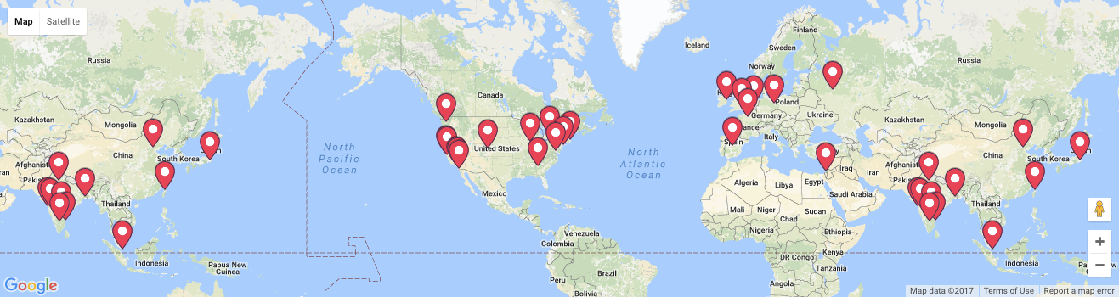


Community Expansion
17th Oct – Amsterdam Meetup
15th Nov – London Meetup
4-5th Dec – H₂O World, Mountain View, CA
12th Dec – London Meetup
15 Meetups a month
Notes:
Note meetups groups were just opened from Feb 7-10.

Slide 23

#AroundTheWorldWithH2Oai

Slide 24
H₂O Machine Learning Platform

Slide 25



High Level Architecture
HDFS
H₂O Compute Engine
S3
Load Data
Exploratory &
Descriptive
Analysis
Supervised &
Unsupervised
Modeling
Predict
Distributed
In-Memory
NFS
Feature Engineering &
Selection
Model Evaluation &
Selection
Data & Model Storage
Loss-less
Compression
Local
Data Prep Export:
Plain Old Java Object
Model Export:
Plain Old Java Object
SQL
Production Scoring Environment
Your
Imagination
Notes:
Works on Hadoop & Spark
Key capabilities
Distributed in-memory algorithms
Columnar compression
Feature Engineering
EDA
Data Munging
Supervised Learning Algorithms
Unsupervised Learning Algorithms
Model deployment via POJO

Slide 26
High Level Architecture
Import Data from Multiple Sources
HDFS
H₂O Compute Engine
S3
Load Data
Exploratory &
Descriptive
Analysis
Supervised &
Unsupervised
Modeling
Predict
Distributed
In-Memory
NFS
Feature Engineering &
Selection
Model Evaluation &
Selection
Data & Model Storage
Loss-less
Compression
Local
Data Prep Export:
Plain Old Java Object
Model Export:
Plain Old Java Object
SQL
Production Scoring Environment
Your
Imagination
Notes:
Works on Hadoop & Spark
Key capabilities
Distributed in-memory algorithms
Columnar compression
Feature Engineering
EDA
Data Munging
Supervised Learning Algorithms
Unsupervised Learning Algorithms
Model deployment via POJO

Slide 27
Supported Formats & Data Sources
File type or Folder of Files
CSV
XLS
XLSX
ORC*
Hive*
SVMLight
ARFF
Parquet
Avro 1.8.0*
HDFS
9 Formats
5 Sources
S3
NFS
LOCAL
SQL
* 1. only if H2O is running as a Hadoop job
* 2. Hive files that are saved in ORC format
* 3. without multi-file parsing or column type modification
Notes:
With the H2O integration for Hadoop you can import a whole range of different file formats including ….
If you have a directory of files with the same shape and labeling you can simply point to the directory path and H2O will combine all
those datasets into a single frame. This is particularly helpful if you use Hive because Hive queries result in lots of part files save to one big directory.
These supported file types can be ingested from any of the following data sources ...
CSV (delimited) files
ORC only if H2O is running as a Hadoop job.
SVMLight
ARFF
XLS
XLSX
Avro version 1.8.0 (without multifile parsing or column type modification)
Parquet
Hive files that are saved in ORC format.

Slide 28
High Level Architecture
Fast, Scalable & Distributed Compute Engine Written in Java
HDFS
H₂O Compute Engine
S3
Load Data
Exploratory &
Descriptive
Analysis
Supervised &
Unsupervised
Modeling
Predict
Distributed
In-Memory
NFS
Feature Engineering &
Selection
Model Evaluation &
Selection
Data & Model Storage
Loss-less
Compression
Local
Data Prep Export:
Plain Old Java Object
Model Export:
Plain Old Java Object
SQL
Production Scoring Environment
Your
Imagination
Notes:
Works on Hadoop & Spark
Key capabilities
Distributed in-memory algorithms
Columnar compression
Feature Engineering
EDA
Data Munging
Supervised Learning Algorithms
Unsupervised Learning Algorithms
Model deployment via POJO

Slide 29

H₂O Core
H2O

Slide 30




H₂O Core
Model Building
CPU

Slide 31
H₂O Core
H2O
H2O
H2O

Slide 32
H₂O Core
Model Building
H2O Distributed In-Memory
CPU
CPU
CPU

Slide 33




H₂O Core
Model Building
H2O Distributed In-Memory
CPU
CPU
CPU
YARN

Slide 34



H₂O Core
Model Building
SQL
NFS
H2O Distributed In-Memory
S3
CPU
CPU
CPU
YARN

Slide 35

H₂O Core
Model Building
SQL
NFS
H2O Distributed In-Memory
S3
CPU
CPU
CPU
YARN

Slide 36
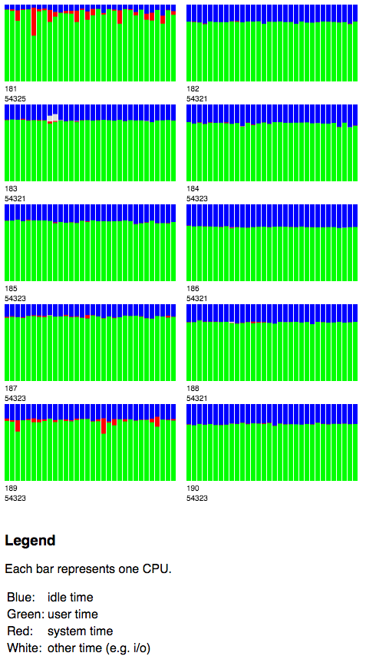

H₂O Water Meter (CPU Monitor)
10 x 32 = 320 Cores

Slide 37
High Level Architecture
Multiple Interfaces
HDFS
H₂O Compute Engine
S3
Load Data
Exploratory &
Descriptive
Analysis
Supervised &
Unsupervised
Modeling
Predict
Distributed
In-Memory
NFS
Feature Engineering &
Selection
Model Evaluation &
Selection
Data & Model Storage
Loss-less
Compression
Local
Data Prep Export:
Plain Old Java Object
Model Export:
Plain Old Java Object
SQL
Production Scoring Environment
Your
Imagination
Notes:
Works on Hadoop & Spark
Key capabilities
Distributed in-memory algorithms
Columnar compression
Feature Engineering
EDA
Data Munging
Supervised Learning Algorithms
Unsupervised Learning Algorithms
Model deployment via POJO

Slide 38
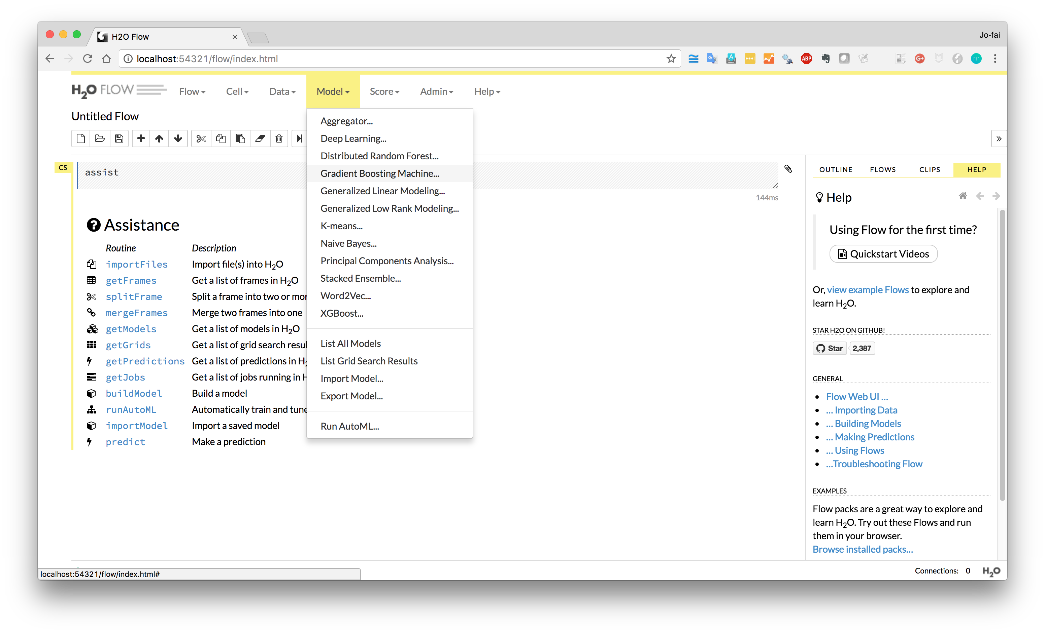
H₂O Flow (Web)

Slide 39
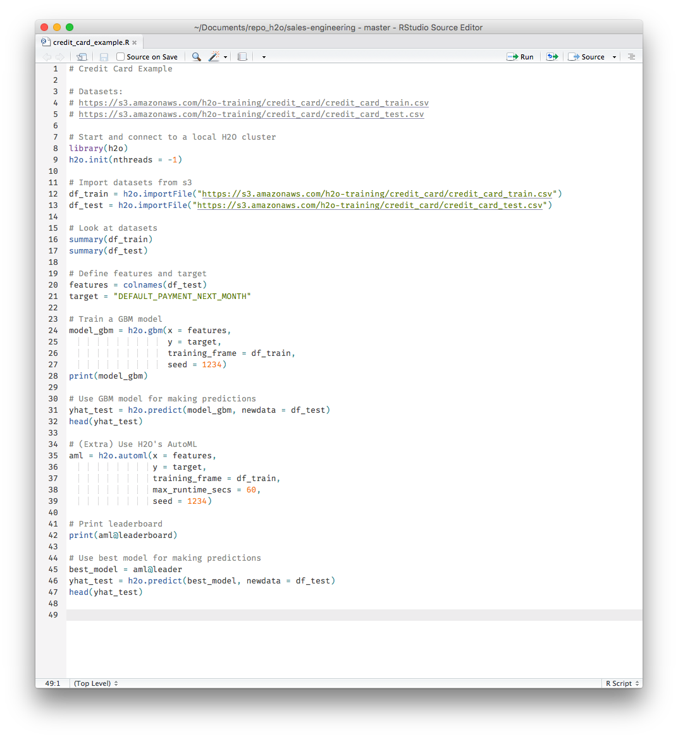
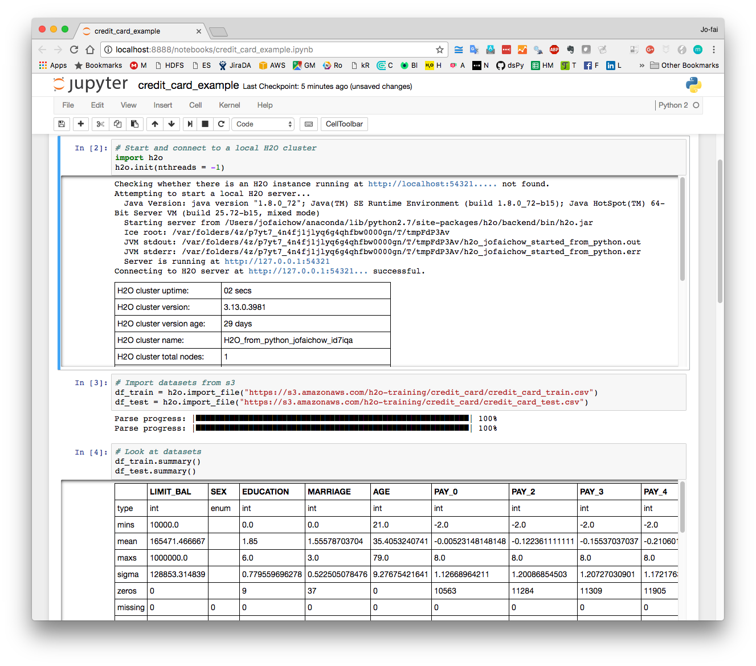
Interface – R and Python

Slide 40
High Level Architecture
Export Standalone Models for Production
HDFS
H₂O Compute Engine
S3
Load Data
Exploratory &
Descriptive
Analysis
Supervised &
Unsupervised
Modeling
Predict
Distributed
In-Memory
NFS
Feature Engineering &
Selection
Model Evaluation &
Selection
Data & Model Storage
Loss-less
Compression
Local
Data Prep Export:
Plain Old Java Object
Model Export:
Plain Old Java Object
SQL
Production Scoring Environment
Your
Imagination
Notes:
Works on Hadoop & Spark
Key capabilities
Distributed in-memory algorithms
Columnar compression
Feature Engineering
EDA
Data Munging
Supervised Learning Algorithms
Unsupervised Learning Algorithms
Model deployment via POJO

Slide 41
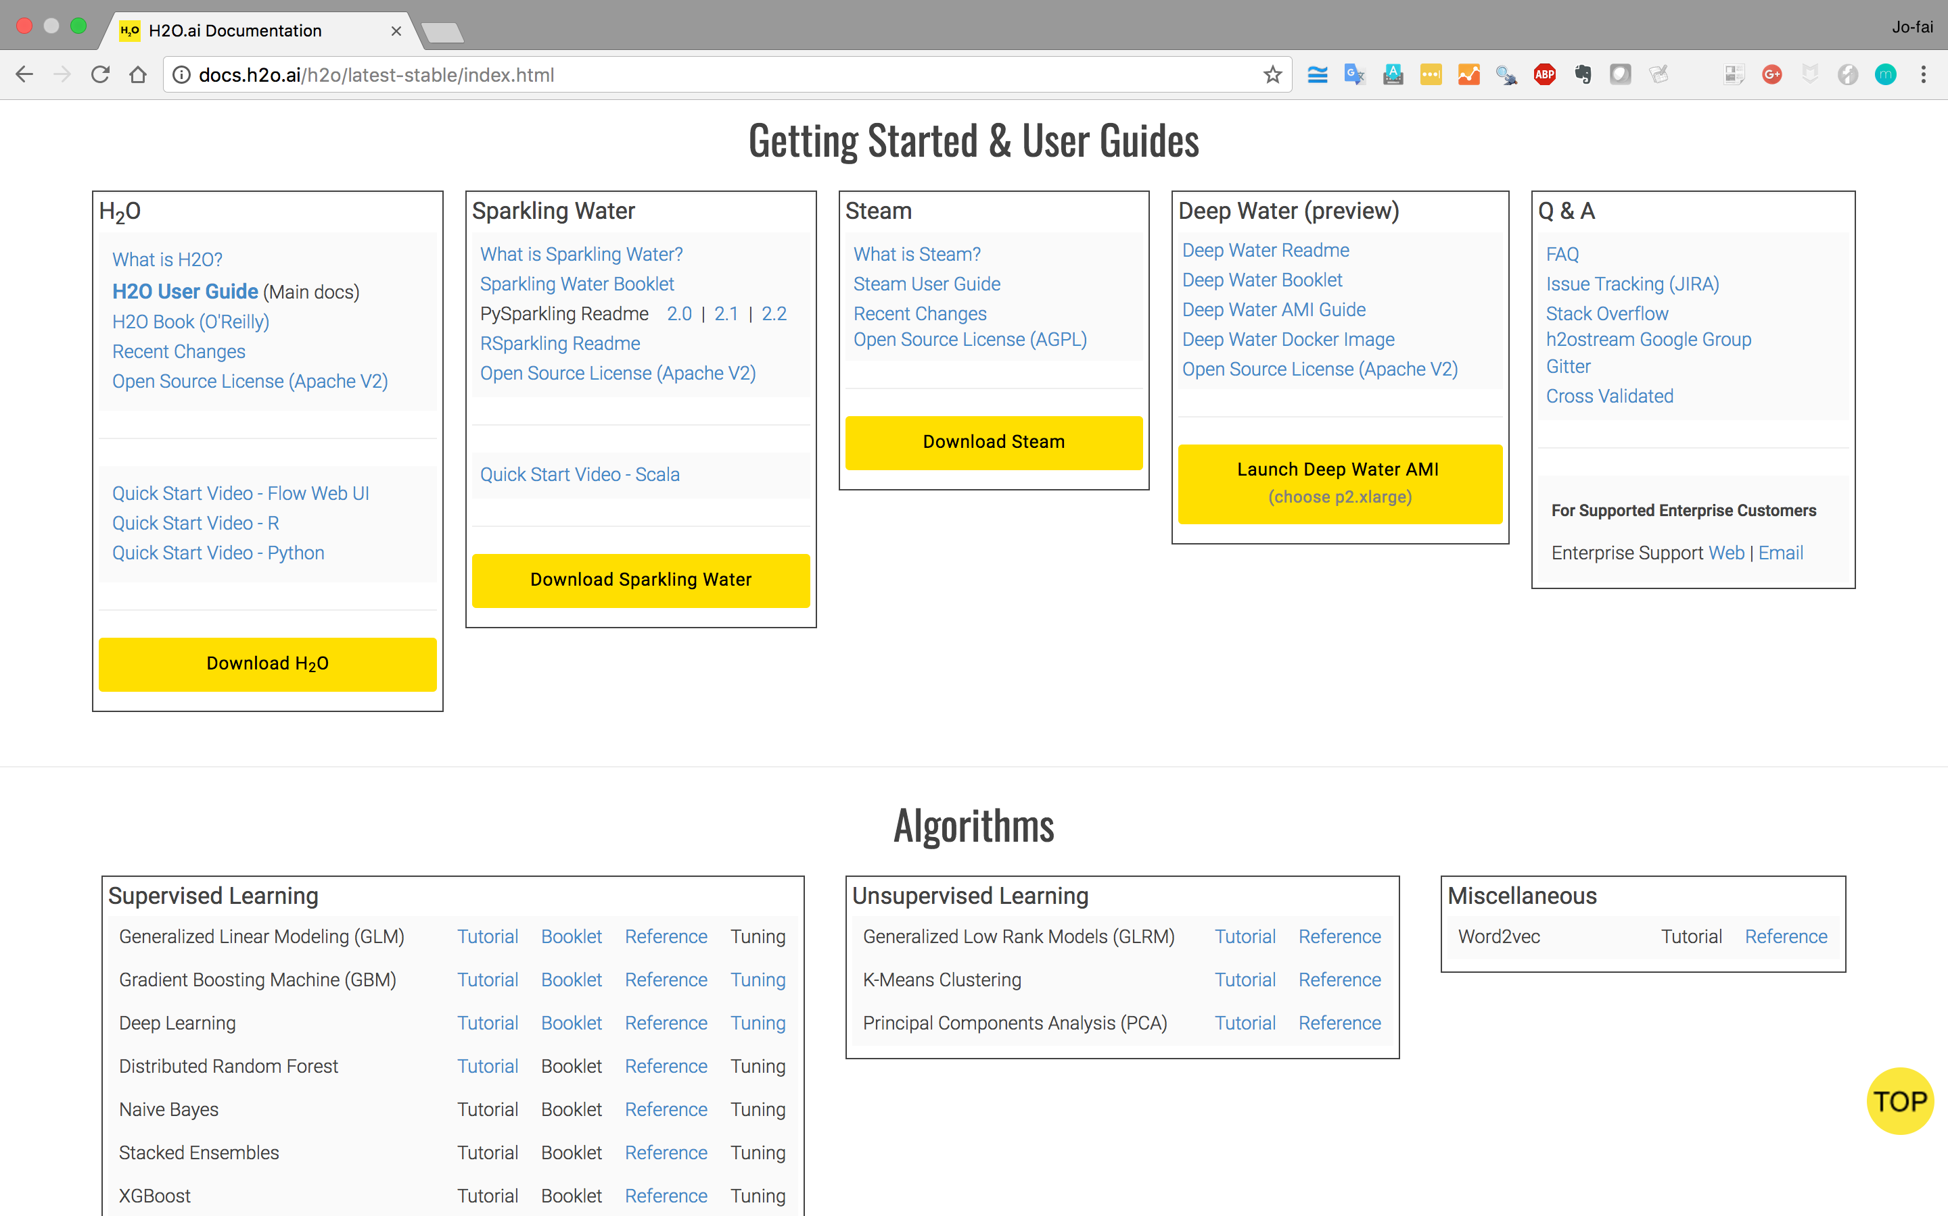
docs.h2o.ai

Slide 42
H₂O Quick Start

Slide 43
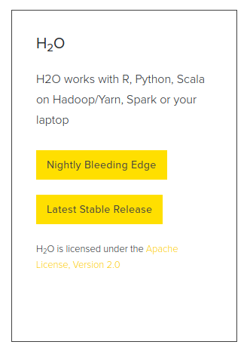
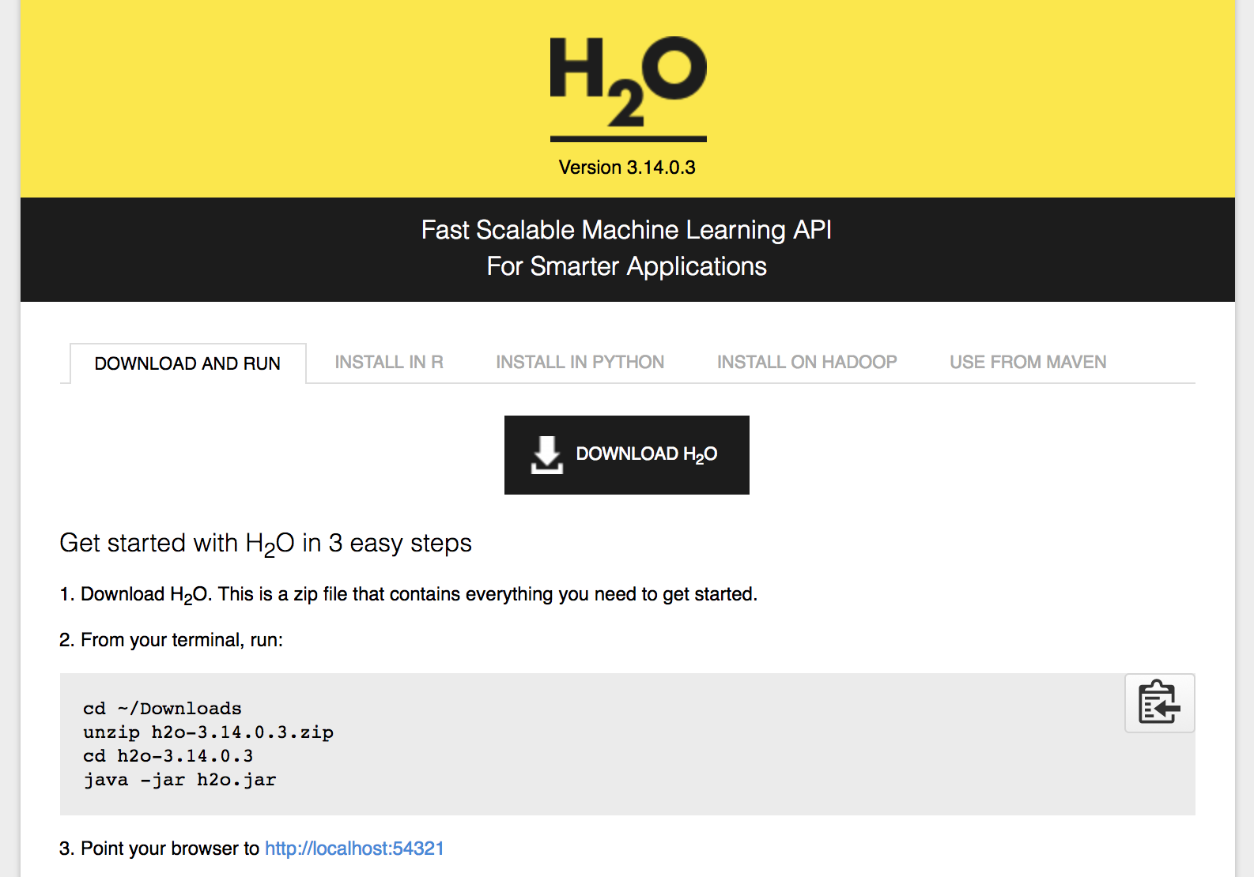
www.h2o.ai/download
Prerequisite: Java version 7 or 8
(Note: Java version 9 is not yet supported)

Slide 44

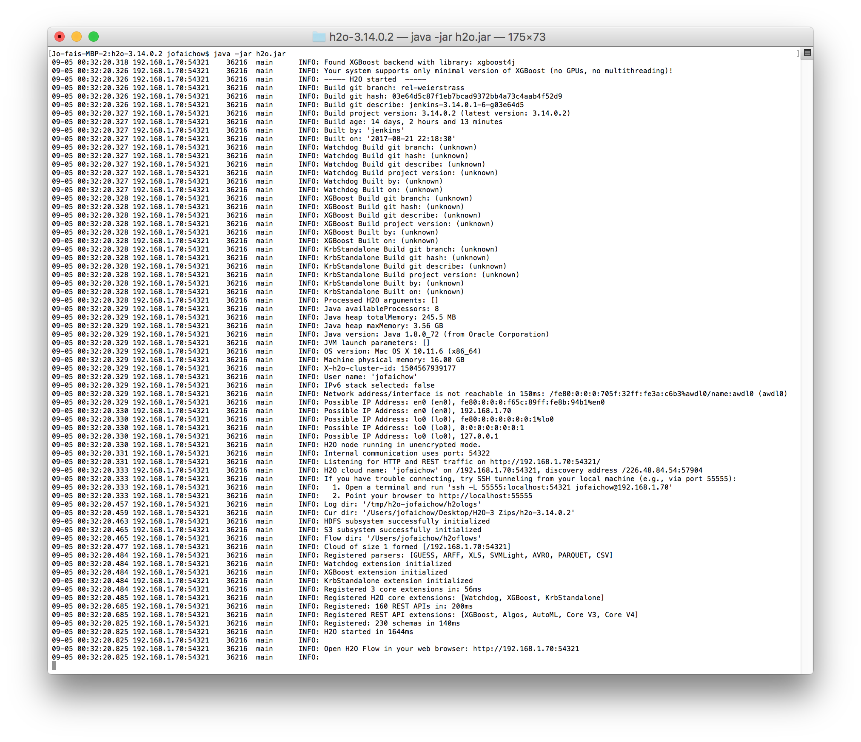
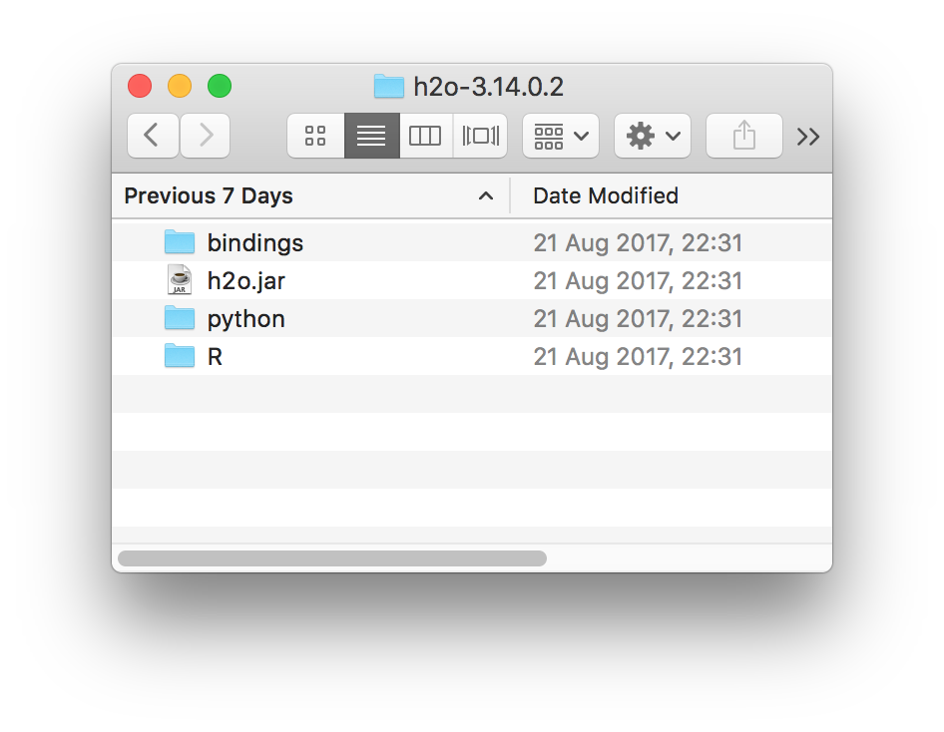
Install and Start H₂O Flow (Web Interface)

Slide 45
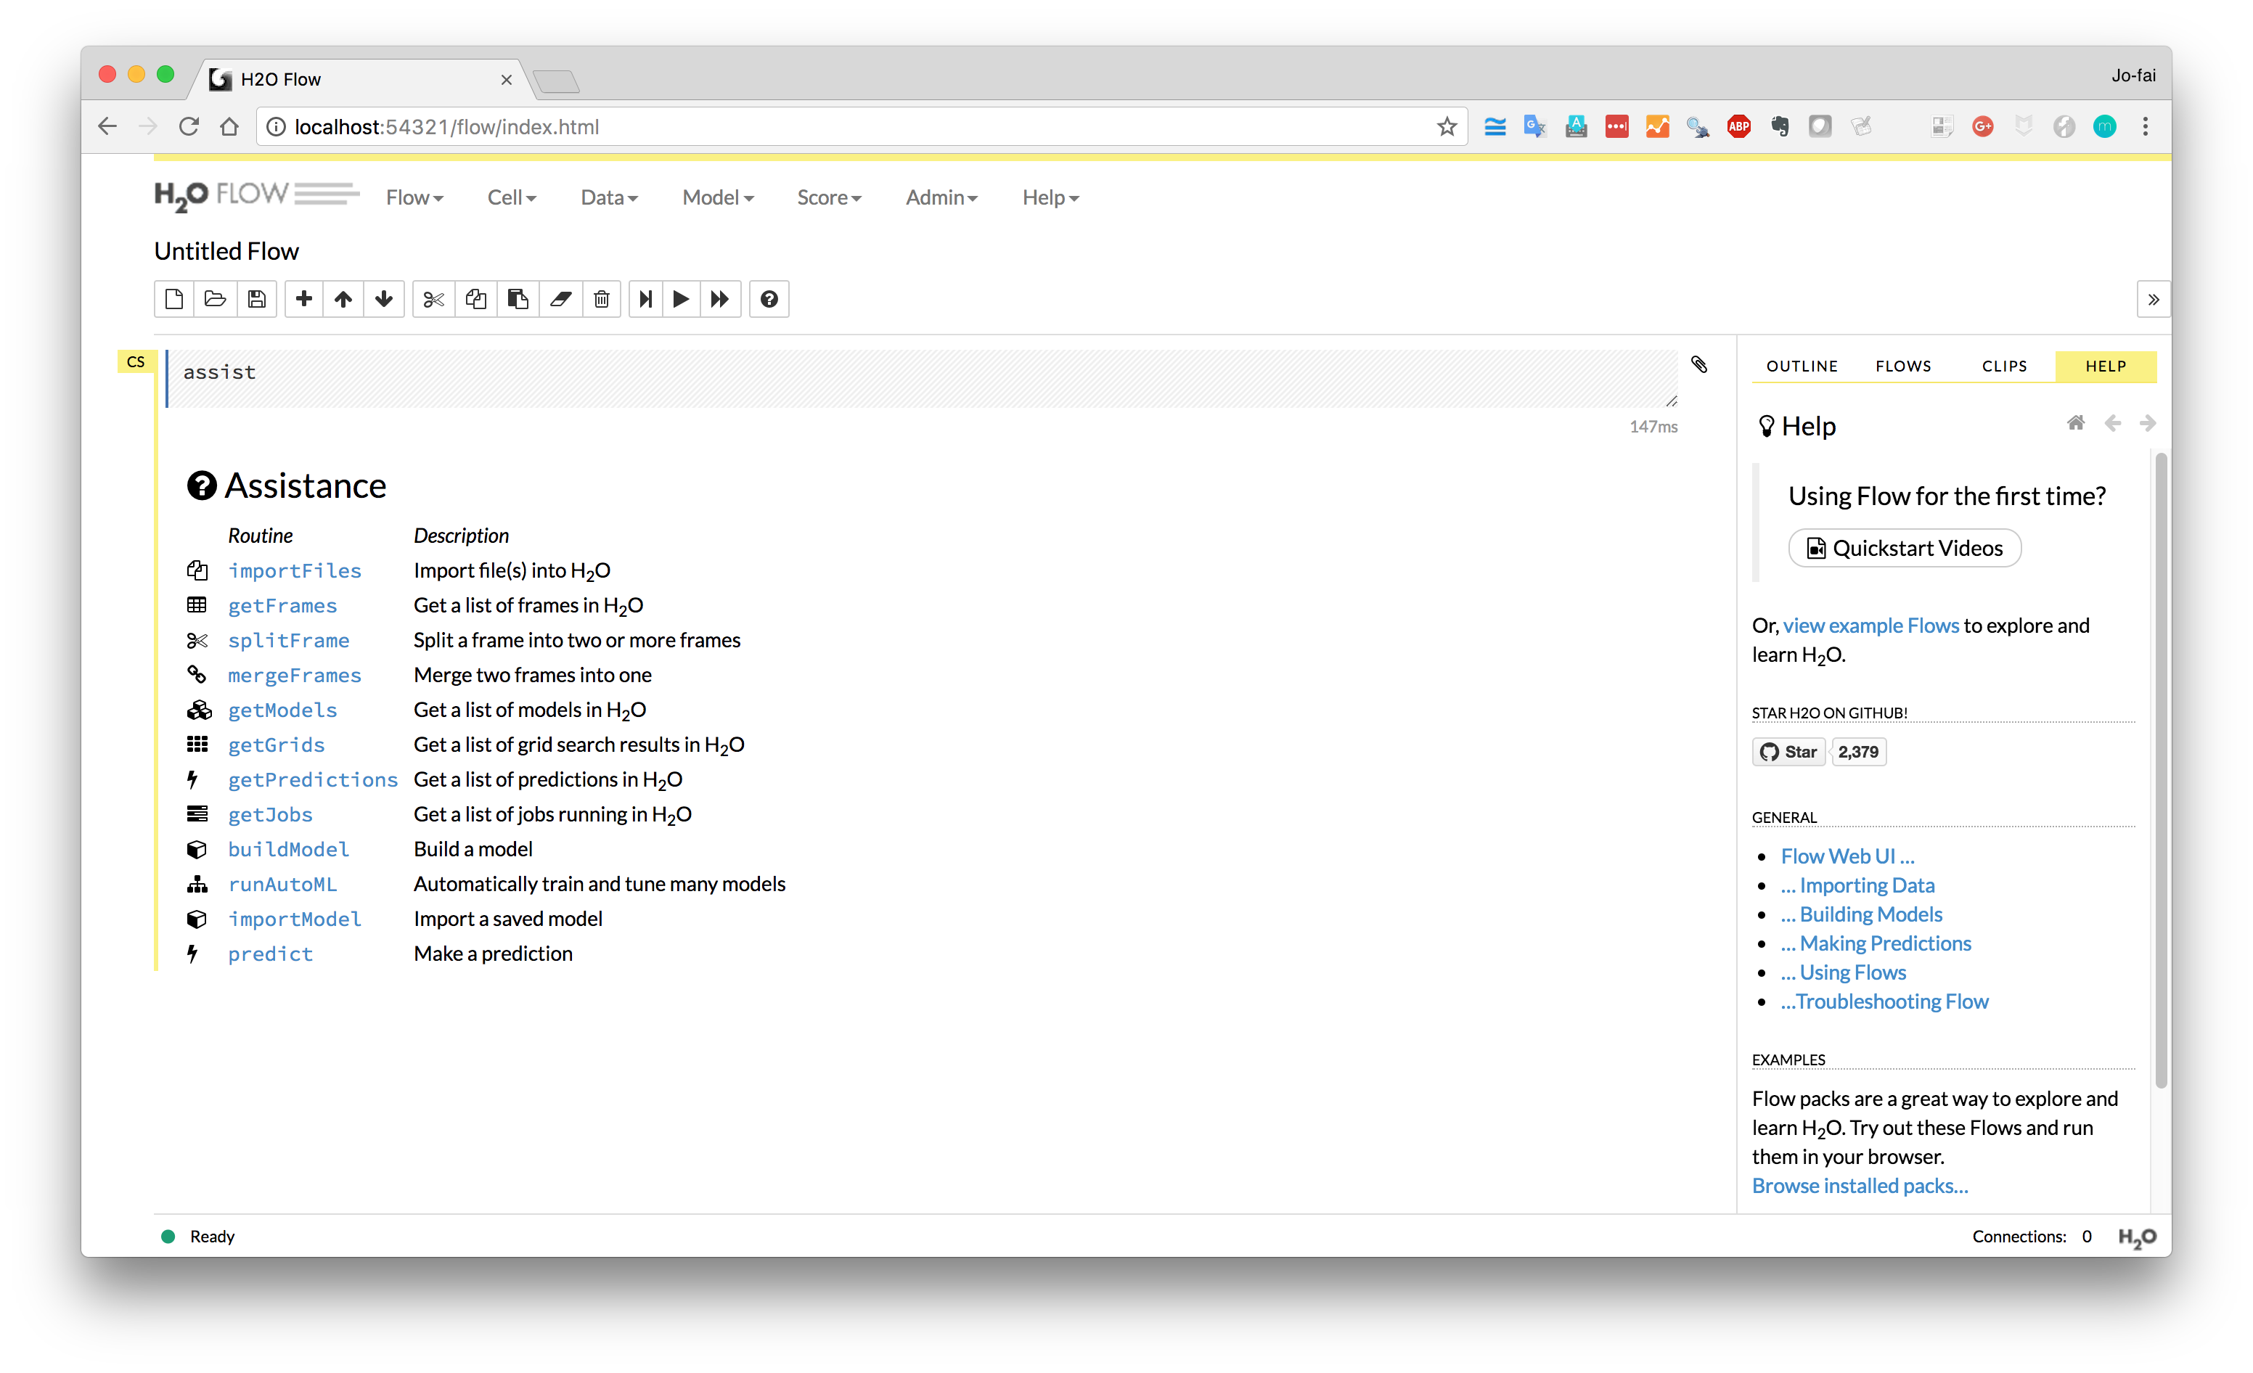
H₂O Flow (Web Interface)
More Examples

Slide 46
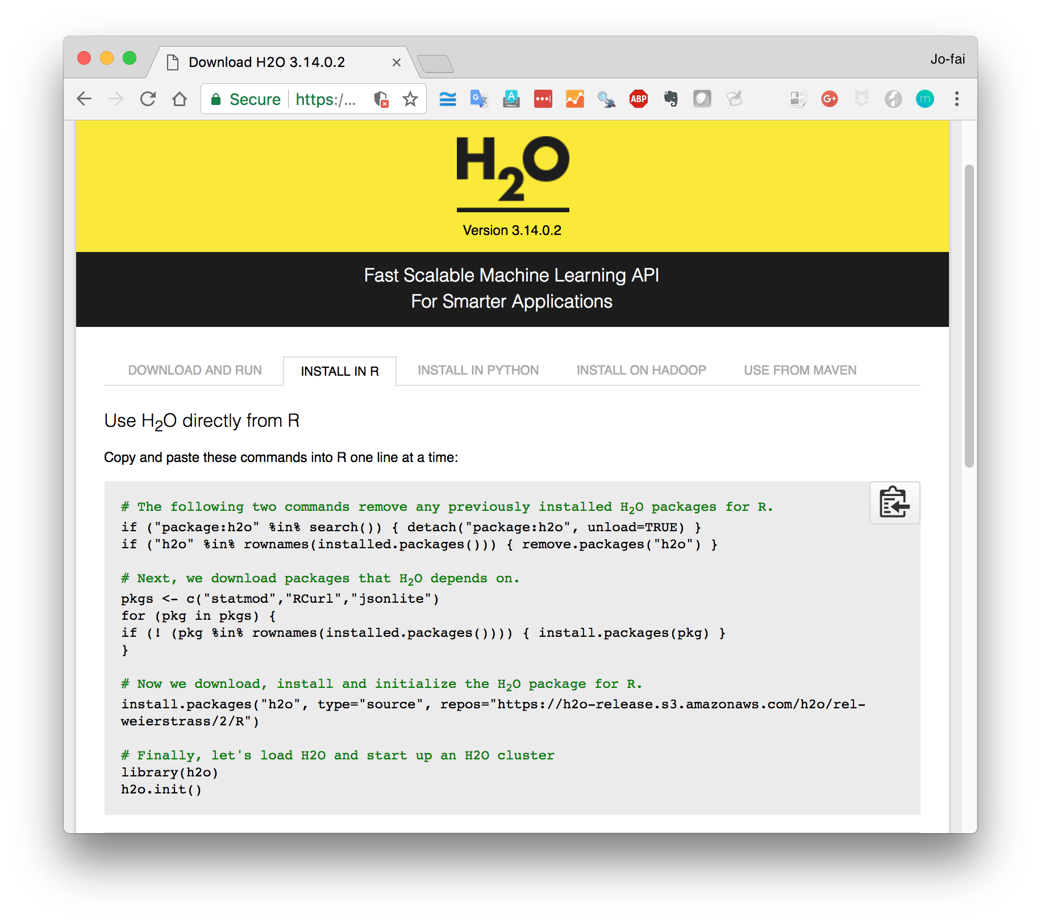
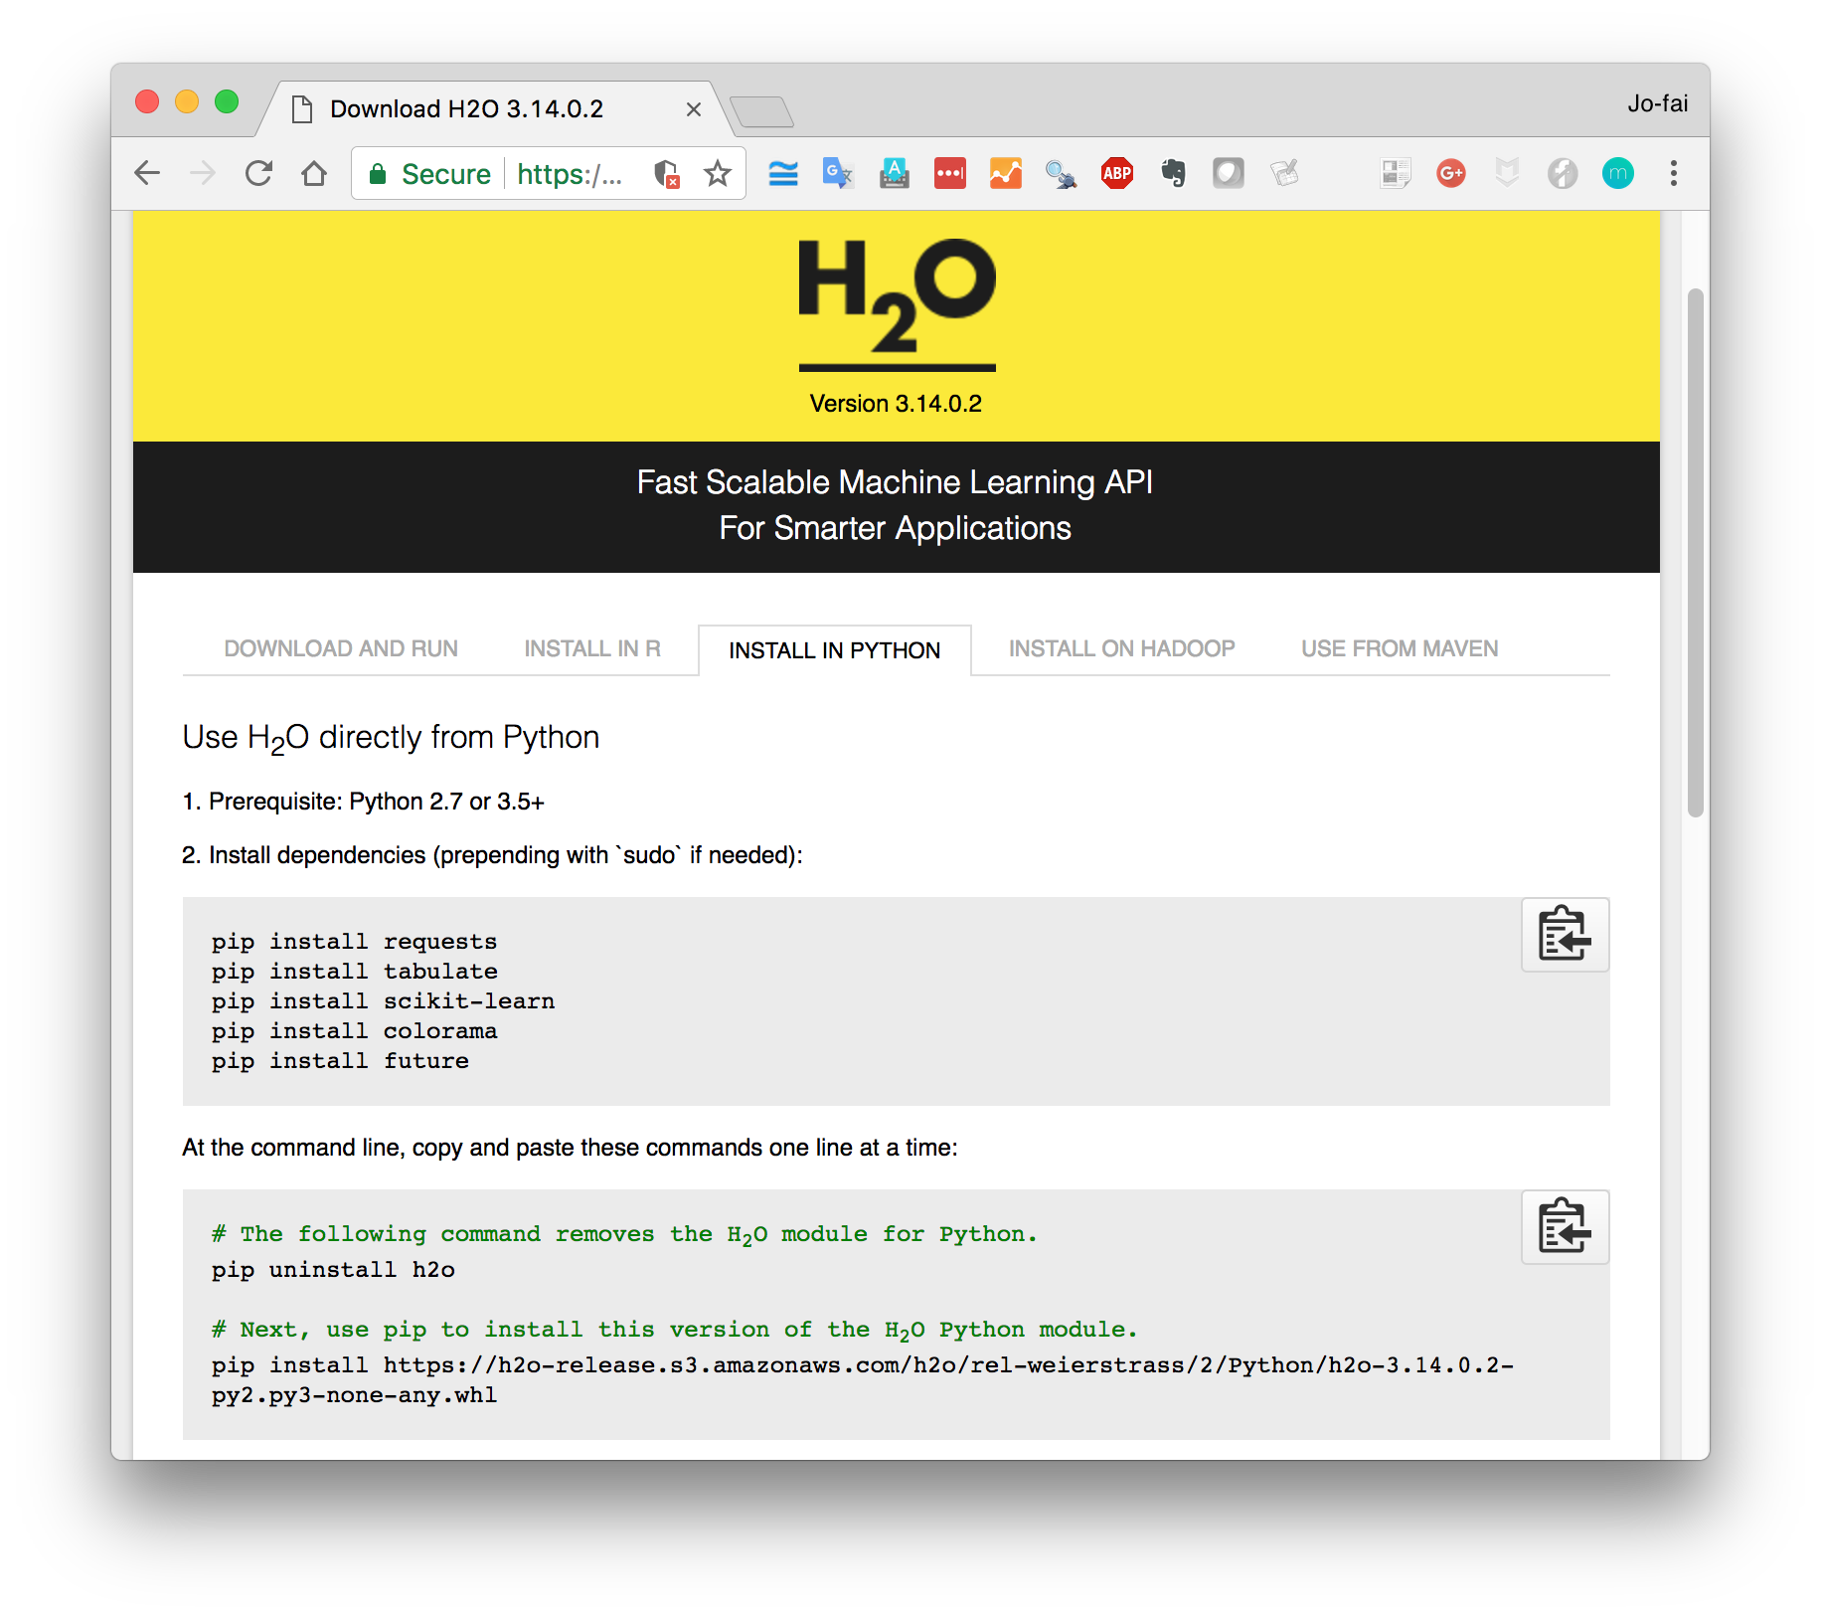
Install and Start H₂O in R / Python

